Slide 1
21st Century Christianity
The 5 People I Talked To About The Gospel

Slide 2
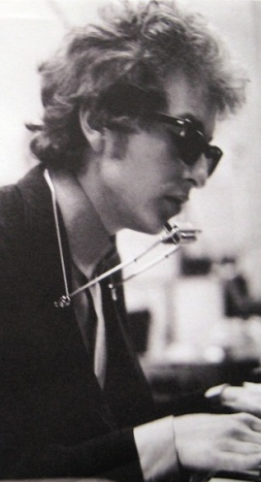
Times They Are A Changin’
Like everything else, Christianity is affected by the changing times
We can be equipped to deal with problems that aren’t really problems anymore
Matthew 28:18-20
We are still called to share the gospel with people, but who are we dealing with?
1st Corinthians 9:20-23
How can we better relate to people?

Slide 3
The Ignorant
God has opened doors for us to work in our community
Through a godly example, we were able to get interest in learning more about the Bible:
Be prepared to start with some people from ground zero
It takes planning, patience, and a lot of work
Don’t get discouraged if they don’t act like Christians, they aren’t
Cultural differences can be a major hurdle in someone accepting Christianity

Slide 4
The Didn’t-Need-Christianity
I developed a survey because it can be awkward to know how to bring up religion to a stranger
People are generally more than happy to talk about what they think
He believed in God, but lost faith in “Religion”
Hypocritical Christians drove him from the church
Felt more spiritual in the woods than he did with Christianity
Still felt like the country is going downhill and people’s morals are slipping

Slide 5
The Didn’t-Know-You-Were-A Christian
We noticed some people studying their Bibles, and waited for a few minutes to talk with them
Instead of looking for differences, take joy in what you have in common (Mark 9:38-40)
Not everyone worshiping somewhere believes everything their church teaches
Someone can actually study and find the truth!
People have willing hearts if you give them an opportunity to be one
You might find more encouragement from unusual places if you talk to more people about God

Slide 6
The Seekers
The internet provides a new medium for people to be exposed to the truth
Do everything in your power to present the truth in the ways people are looking to communicate
People can be looking for new testament Christianity – would they find you?
Most “Christians” will come with a lot of baggage – be prepared for it
Treat people with love so they can see Christ in you
Maturing in Christ will take time, but love can carry you the distance

Slide 7
Already A “Christian”
A lot of people in the Bible belt are already in some kind of relationship with God
It can be difficult to convince someone they need to change when they are content
There is a difference in the level of teaching at many congregations
Over time, disagreements are easier to discuss once you’ve built trust
Be able to explain your convictions with truth and love
Some fruit won’t be born until years down the road

