Slide 2
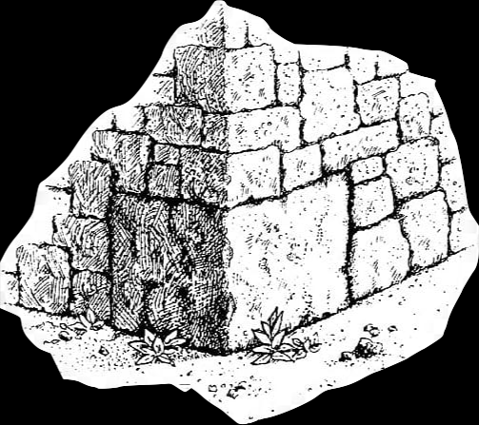
Jesus The Cornerstone
Acts 4:10-12
Building…
Level
Plumb
Square
Not Just
One Of These
Jesus Is Everything
To Me!
Matt. 21:42 Mk. 12:10
Lk. 20:17
Q= Psa. 118:22
Jesus…
The Dividing Point
Romans 9:32-33

Slide 3
Only Right Foundation
1 Corinthians
3:10-11
Born Again
God’s Way - God’s Message
1 Peter 1:3, 23-25

Slide 4
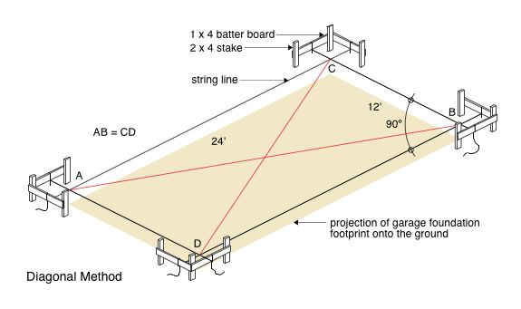

Slide 5
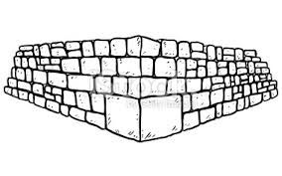
Jesus Builds…
His People (Discipleship)
Our Relationships
His Church - Temple - Kingdom
Lives
Families
Congregations

Slide 6
It Matters How We Build
It Matters Where We Build
It Matters With What We Build
Moving
Forward…
Building Takes…
Decisions
Time
Focus
Effort
Adjustment
Patience
Dig Deep
Luke 6:48

Slide 7
Glorious Temple
As God Wants It…
Ezekiel 40-48

Slide 8
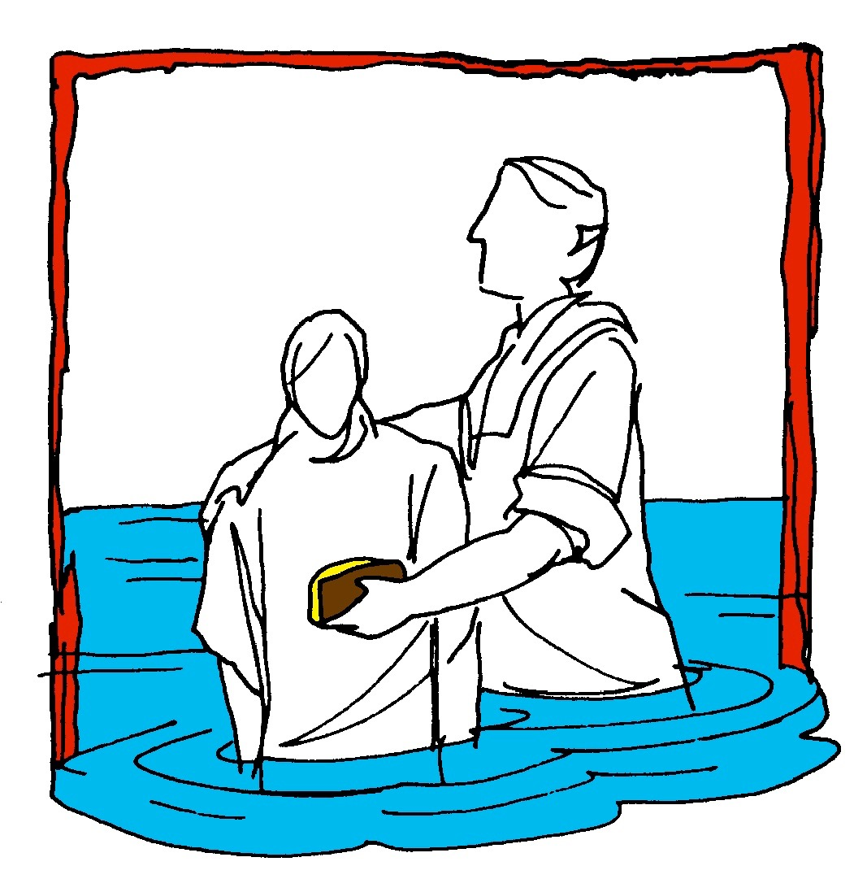
Hear (Rom. 10:17)
Believe (Jn. 8:24)
Repent (Acts 2:38)
Confess (Mt. 10:32-33)
Baptism (Acts 22:16)
Mk. 16:
15-16
Continue… (Mt. 28:20)

