Slide 1
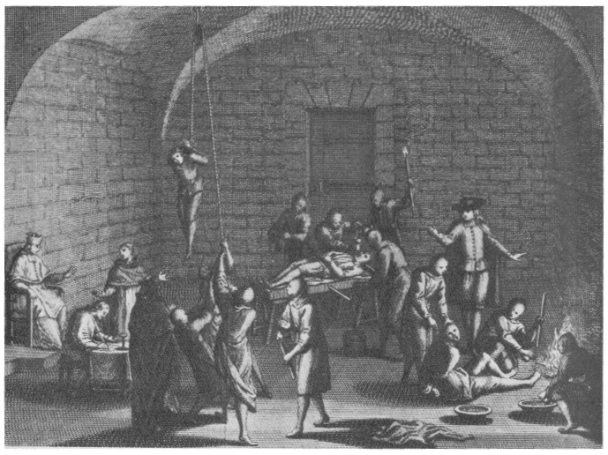
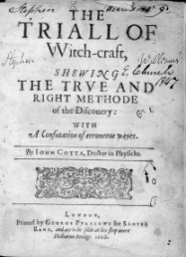
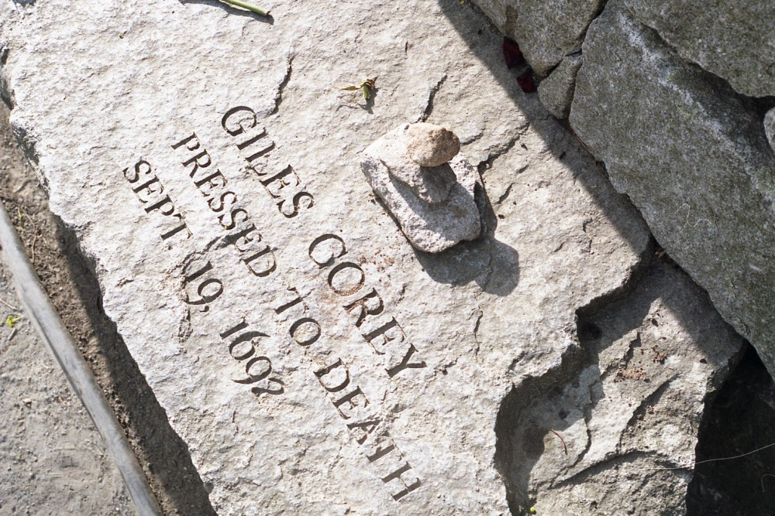
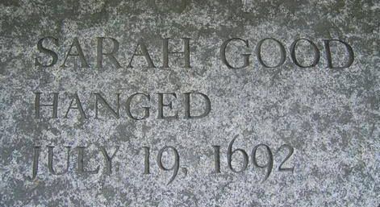
Religion
All verses from the ESV
Notes:
Only 7% of recorded wars were due to religion. Removing Islam from the mix it is 3.2%.
Christian Religious actions:
Crusades
Inquisition
Salem Witch Trials

Slide 2
Religion (G2356 - θρησκεία)
Four Occurrences:
Acts 26:5 – “…that according to the strictest party of our religion I have lived as a Pharisee.”
Colossians 2:18 – “Let no one disqualify you, insisting on asceticism and worship of angels, going on in detail about visions, puffed up without reason by his sensuous mind…”
James 1:26-27 – “If anyone thinks he is religious and does not bridle his tongue but deceives his heart, this person's religion is worthless. Religion that is pure and undefiled before God, the Father, is this: to visit orphans and widows in their affliction, and to keep oneself unstained from the world.”
Outline of Biblical Usage:
Religious worship, especially that which consists of ceremonies
It is the external, visible acts of worship
According to James it can be:
Pure and
Undefiled
or
Worthless

Slide 3
Worthless Religion
Uncontrolled Tongue
James 3:1-12
1 Peter 3:8-12
Religion over Obedience
1 Samuel 15
Hosea 6:6
Psalm 51:16-17
Pharisees – Matthew 23:27-28

Slide 4
Pure and Undefiled Religion
Visit Widows and Orphans
Why these two groups?
Exodus 22:21-24 – “You shall not wrong a sojourner or oppress him, for you were sojourners in the land of Egypt. You shall not mistreat any widow or fatherless child. If you do mistreat them, and they cry out to me, I will surely hear their cry, and my wrath will burn, and I will kill you with the sword, and your wives shall become widows and your children fatherless.”
Deuteronomy 27:19 – “‘Cursed be anyone who perverts the justice due to the sojourner, the fatherless, and the widow.’ And all the people shall say, ‘Amen.’”
Isaiah 1:16-17 – “Wash yourselves; make yourselves clean; remove the evil of your deeds from before my eyes; cease to do evil, learn to do good; seek justice, correct oppression; bring justice to the fatherless, plead the widow's cause.”
Zechariah 7:9-10 – “Thus says the Lord of hosts, Render true judgments, show kindness and mercy to one another, do not oppress the widow, the fatherless, the sojourner, or the poor, and let none of you devise evil against another in your heart.”

Slide 5
Visit (G1980 – ἐπισκέπτομαι)
Several Uses in the Bible
Matthew 25:31-46
Luke 7:16 - “Fear seized them all, and they glorified God, saying, ‘A great prophet has arisen among us!’ and ‘God has visited his people!’”
Acts 6:3 – “Therefore, brothers, pick out from among you seven men of good repute, full of the Spirit and of wisdom, whom we will appoint to this duty.”
Acts 15:36 – “And after some days Paul said to Barnabas, ‘Let us return and visit the brothers in every city where we proclaimed the word of the Lord, and see how they are.’”
Outline of Biblical Usage
to look upon or after, to inspect, examine with the eyes
in order to see how he is, i.e. to visit, go to see one (the poor and afflicted, the sick)
to look upon in order to help or to benefit (to look after, have care for, provide for: of God)
to look (about) for, look out (one to choose, employ, etc.)

Slide 6
Side Point – Orphan Homes
Notice the personal pronoun emphasis of this passage and its context:
"anyone" – James 1:23
"he", "his" – James 1:23
"himself", "he" – James 1:24
"he", "this one" – James 1:25
"anyone", "he", "his", "this one's" – James 1:26
"oneself" – James 1:27
Recall the definition of visit – money is not required or the focus of visiting
Two conclusions:
First, James 1:26-27 cannot be used as authority for the church to send money to Orphans homes
Second, we, individually, need to be visiting orphans and widows in their need.

Slide 7
Pure and Undefiled Religion
Unstained from the world
Language
Stains defined: Works of the Flesh – Galatians 5:19-21
Stark contrast to the fruits of the Spirit – Galatians 5:22-24

