Slide 2
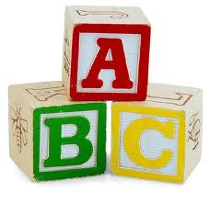
BACK TO THE BASICS
A Study of the
First Principles

Slide 4
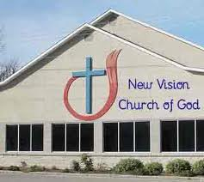
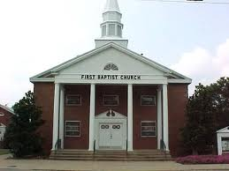
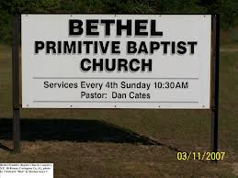
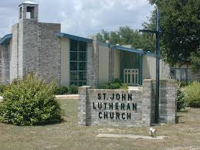
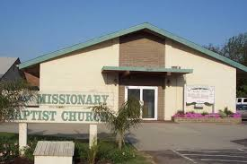
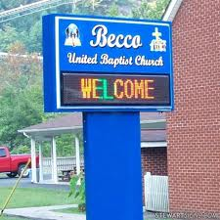
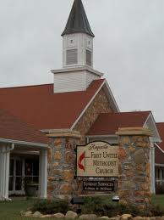
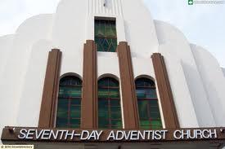
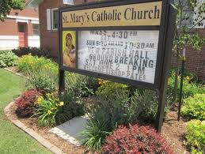
Many believe that all churches are equal

Slide 5
Many Believe All Churches are Equal Regardless of Differences in Their…..
name
members
beginnings
beliefs
doctrine
organization
works

Slide 6
ARE ALL CHURCHES EQUAL IN GOD’S EYES?
Lesson 2
Back to the Basics

Slide 7
The Religious World is Divided
Denominations are the norm in the religious world today
According to Gordon-Cornwell Theological Seminary, as of 2010, there are over 41,000 ‘Christian’ denominations and organizations
Few people see much distinction between denominations
Does God recognize all of these denominations as equals?
Are they all pleasing to Him?

Slide 8
Not All Churches Are Equal……
If we consider……….
The Members of Each Church
The Founder of Each Church
The Actions of Each Church
The Bible’s Teachings About ‘Churches’

Slide 9
Not All Churches Are Equal……
If we consider……….
The Members of Each Church
The Founder of Each Church
The Actions of Each Church
The Bible’s Teachings About ‘Churches’

Slide 10
I. The Members of Each Church
Define the church
World has various concepts of the church
Some speak as if the church is literal building
Most believe God has multiple churches
There are different flavors for people’s different desires
God is accepting of all churches
Church is not the building but body of Christ
Saul made havoc of the church, the people (Acts 8:3)
Church is the body (Eph. 1:22-23)
Body is the church (Col. 1:18)

Slide 11
I. The Members of Each Church
Eph. 1:22-23: “And He put all things under His feet and gave Him to be head over all things to the church, which is His body, the fullness of Him who fills all in all.”
THE CHURCH AND THE BODY OF CHRIST ARE ONE AND THE SAME
Col. 1:18: “And He is the head of the body, the church, who is the beginning….”

Slide 12
I. The Members of Each Church
Define the church
World has various concepts of the church
Church is not the building but body of Christ
Word ‘church’
Comes from the Greek word “ekklesia”
ek – to go; klesia- to call; Ekklesia- those called out
Those called out of darkness towards light (I Pet. 2:9)
Called out by the gospel (II Thess. 2:14)
We were far from Christ in sin, but brought close by Him (Eph. 2:13,16)

Slide 13
I. The Members of Each Church
Define the church
Church made of people in saved relationship with God
On Pentecost, those added to church were saved (Acts 2:47)
We are reconciled to God in one body (Eph. 2:16)
Christ is Savior of body, those in body are saved(Eph. 5:23)

Slide 14
I. The Members of Each Church
Define the church
Church made of people in saved relationship with God
Church is family of God
Paul wrote to Timothy concerning his actions in house of God, which is the church (I Tim. 3:15)
Is not referring to a physical building
House of God is family of God, same as house of David is family of David

Slide 15
I. The Members of Each Church
Define the church
Church made of people in saved relationship with God
Church is family of God
Terms of entrance into church and salvation the same
Scripture teaches these are the same
Acts 2:47 plainly shows the similarity

Slide 16
Not All Churches Are Equal……
If we consider……….
The Members of Each Church
The Founder of Each Church
The Actions of Each Church
The Bible’s Teachings About ‘Churches’

Slide 17
II. The Founder of Each Church
Bible teaches founder of church is Jesus Christ
Jesus claims the church as His own (Matt. 16:18)
Only foundation we should build on is Christ (I Cor. 3:5-11)
Christ is the chief cornerstone of our faith (I Pet. 2:4-8)

Slide 18
II. The Founder of Each Church
Bible teaches founder of church is Jesus Christ
Any other church founder is mere man
Baptist- founded by John Smyth in 1610 in England
Methodist- founded by John Wesley in 1738 in England
Catholic- founded by Roman Emperor Constantine in 313
Presbyterian- founded by French reformer John Calvin in 16th century
Mormon- founded by Joseph Smith in 1830 in New York
church of Christ- founded by Jesus Christ, the Son of God upon his death, resurrection, and ascension back to heaven and preached of by Peter in Acts 2

Slide 19
II. The Founder of Each Church
Bible teaches founder of church is Jesus Christ
Any other church founder is mere man
Church not founded by God will be uprooted (Matt. 15:13)
Anyone teaching another doctrine will be accursed (Gal. 1:6-8)

Slide 20
Not All Churches Are Equal……
If we consider……….
The Members of Each Church
The Founder of Each Church
The Actions of Each Church
The Bible’s Teachings About ‘Churches’

Slide 21
III. The Actions of Each Church
Their doctrine
Salvation by faith alone (James 2:20-24)
Baptism of infants (Acts 18:8)
Keeping Old Testament law (Gal. 3:22-25)
Calvinism (Rom. 2:11)
Ect…..

Slide 22
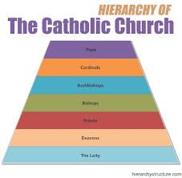
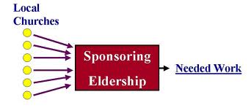
III. The Actions of Each Church
Their doctrine
Their organization
‘Pastor’ ruling as head
Man made leadership
pope, cardinals, bishops
Board of directors
Sponsoring churches
Deacons leading in place of elders
Ect……
- Correct organization- Christ is universal head in heaven (Col. 1:18) & elders lead locally (Acts 20:28)

Slide 23
III. The Actions of Each Church
Their doctrine
Their organization
Their name
Many think name does not matter
Some named after men (Lutheran)
Some named after practice (Baptist)
Some after organization (Presbyterian)
Ect……….
Whatever we do must be in name of Christ, by His authority (Col 3:17)
Authorized names: church of Christ (Rom. 16:16), church of God (I Cor. 1:2), and the body (Eph. 5:23)

Slide 24
III. The Actions of Each Church
Their doctrine
Their organization
Their name
Their worship
Instrumental music (Col. 3:16)
Irregular observance of Lord’s Supper (Acts 20:7 & I Cor. 11: 26)
Observance of Sabbath (Acts 20:7)
Etc…..

Slide 25
III. The Actions of Each Church
Their doctrine
Their organization
Their name
Their worship
Their authority
Man’s thoughts and ideas (Baptist, Methodist, etc..)
Man’s creeds (Catholicism)
Special late revelation (Mormonism)
Etc…….
- Correct authority: Use God’s word as only authority for religious practices (Matt. 28:18-19; Heb 1:1-2; II Tim. 3:16-17)

Slide 26
Not All Churches Are Equal……
If we consider……….
The Members of Each Church
The Founder of Each Church
The Actions of Each Church
The Bible’s Teachings About ‘Churches’

Slide 27
IV. The Bible’s Teachings About Churches
Only one church is ever spoken of
Jesus only promised one church (Matt. 16:18)
Every prophesy speaks of one church/kingdom
The mountain of the Lord’s house, the kingdom (singular), would be established in latter days (Isa. 2:2 & Micah 4:1)
Daniel said singular kingdom would never be destroyed (Dan. 2:44)
Jesus stated some of His disciples would see kingdom established with power (Mark 9:1)
Jesus, while giving model prayer, stated that they should pray for Father’s kingdom come (Matt. 6:10)

Slide 28
IV. The Bible’s Teachings About Churches
Only one church is ever spoken of
Jesus only promised one church (Matt. 16:18)
Every prophesy speaks of one church/kingdom
Bible teaches there is just one body
Paul teaches there is just one body (Rom. 12:1-5)
Different gifts but in one body (I Cor. 12:1-12)
Paul describes the himself and the Corinthians as being one bread and one body (I Cor. 10:17)
All baptized into one body (I Cor. 12:13)

Slide 29
IV. The Bible’s Teachings About Churches
Only one church is ever spoken of
Bible is silent about churches
Not referring to multiple local groups, “churches of Christ salute you”
Meaning no denominations ever mentioned
We must speak where bible speaks, keep silent when silent (I Peter 4:11)
No permission is a prohibition (Heb. 7:14)
We must teach/preach what is written in the word (II Tim. 4:1-2)

Slide 30
IV. The Bible’s Teachings About Churches
Only one church is ever spoken of
Bible is silent about churches
It makes a difference what one believes
We have objective standard
All scripture inspired of God (II Tim. 3:16-17)
We must believe and speak what is written (II Cor. 4:13)
Words written by apostles are commands (I Cor. 14:37)
It is possible to believe a lie (II Thess. 2:11)
We must act according to God’s pattern (Heb. 8:5)

Slide 31
IV. The Bible’s Teachings About Churches
Only one church is ever spoken of
Bible is silent about churches
It makes a difference what one believes
Division is wrong
If denominationalism is right then division is ok
Bible teaches that divisions is wrong
Jesus prayed for His people to be united (John 17:20-21)
Paul wrote to Corinthians that they all speak the same thing, be of same mind, and same judgment (I Cor. 1:10)

Slide 32
Not All Churches Are Equal……
If we consider……….
The Members of Each Church
The Founder of Each Church
The Actions of Each Church
The Bible’s Teachings About ‘Churches’

