Slide 1
For What Do You Hunger?
Mt. 5:6

Slide 2
Summary of God’s Expectations
Fear God & keep His commands – Eccl. 12:13.
Active love & faith with action – Jam. 2:15-18.
Place God & others above self – Lk. 10:25-37.
Everything flows from this principle.
We will obey God because we are striving to do His will – 1 Jn. 2:3.
We place our desires in subjection to His – Jam. 3:13-18.

Slide 3
Obedience & Unselfishness
Works of Flesh v. Fruit of the Spirit – Gal. 5
Types of Sin v. Self-Control – 1 Jn. 2:15-16.
“Addictions”
Drugs
Alcohol
Tobacco
Gambling
Illicit Sex
Prescriptions
Work
Shopping
Caffeine
Hobbies
Social media
Hording
What about food???

Slide 4
Food is necessary for our physical survival, but gluttony is sinful.

Slide 5
What Gluttony Is Not
A regular meal – 1 Cor. 11:22
A social meal – Mt. 11:18-19; Gal. 2:12
Feast
Commanded in Old Testament – Num. 29:12
Approved by Jesus – Lk. 14:13

Slide 6
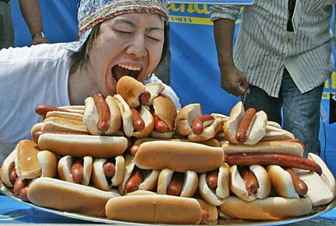
What Gluttony Is
Zalal (Hebrew) – “Riotous eater”; to be loose morally or worthless.
Phagos (Greek) – One who eats (meat).

Slide 7
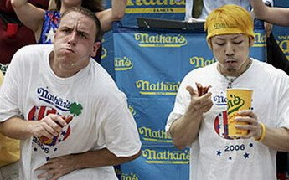
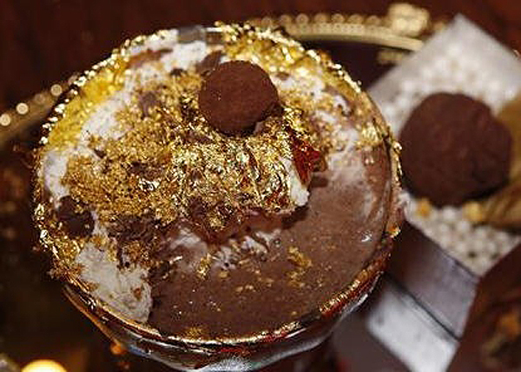
What Gluttony Is
Overconsumption of food – Prov. 25:16
Yielding to intense craving – Num. 11:4-6, 33
Putting food first – Gen. 25:29-34; Heb. 12:16
Excessive extravagance – Dan. 1:5, 9, 12-15

Slide 8
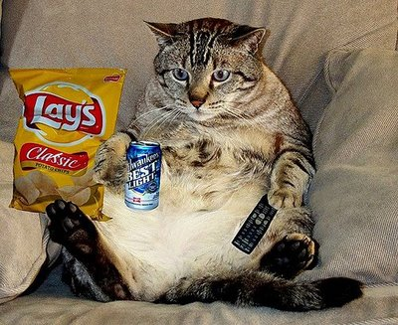
Connotations with Gluttony
Deut. 21:18-21 – Stubborn, rebellious, disobedient
Prov. 23:20-21 – Winebibber, drunkard
Prov. 23:2 – Deceptive
Prov. 28:7 – Shame
Tit. 1:12 – Liars, evil beasts, lazy

Slide 9
We Must Exercise Self-Control
Gal. 5:22 – Self-control is a Fruit of the Spirit
2 Pet. 1:5-7 – Needed to bear fruit
2 Cor. 10:4-5 – Bring every thought into captivity…

Slide 10
Which is Better?
Fill ourselves as much as possible
Spend excessively on food
Eat like a ravenous animal
Share with those in need
Moderate our food budget
Use temperance, etiquette, manners
Blessed are those who hunger and thirst after righteousness, for they shall be filled.

