Slide 1
We Will “Glorify”& Bring “Glory” (part 1)
The KJV translates “doxazō” (Strong’s G1392) 62 times in the following manner: glorify (54x), honour (3x), have glory (2x), magnify (1x), make glorious (1x), full of glory (1x).
Closely related is “doxa ” (Strong’s G1391): The KJV translates G1391 in the following manner: glory (145x), glorious (10x), honour (6x), praise (4x), dignity (2x), worship (1x).

Slide 2
We Will “Glorify”& Bring “Glory” (part 1)
M. Websters: Definition of GLORIFY; transitive verb
1a. to make glorious by bestowing honor, praise, or admiration 1b. to elevate to celestial glory
2. to light up brilliantly
3a. to represent as glorious: extol <a song glorifying romantic love>3b. to cause to be or seem to be better than the actual condition <the new position is just a glorified version of the old stockroom job>
4. to give glory to (as in worship)— glo•ri•fi•ca•tion noun; — glo•ri•fi•er noun

Slide 3
In the NT we have scriptures that refer to:
The glory and honor expressed when Jesus was born (Luke 2:14, 2:20)
People glorifying Jesus and God when they witnessed a miracle (Matthew 15:31, Luke 17:5)
The glory that God possesses in Heaven (Acts 7:55, Romans 11:36)
The glory that a man like Solomon or Moses possessed (Matthew 6:29, Luke 12:27, Hebrews 3:3)
God showing His Glory to men such as Abraham, Moses, or Isaiah (Acts 7:2, John 12:41, 2 Corinthians 3:7)
Bringing honor, praise, and admiration for God’s blessings and God’s Word; especially in worship (Luke 19:38, John 1:14, Acts 13:48, 2 Thessalonians 3:1, Hebrews 1:3, Revelation 14:6, 15:4)
Jesus being glorified after His resurrection and ascension to Heaven (John 12:16, 12:23, 17:1, 17:5)
Jesus returning in His Glory to receive His own and execute judgment (Mark 8:38, 2 Thessalonians 1:9)

Slide 4
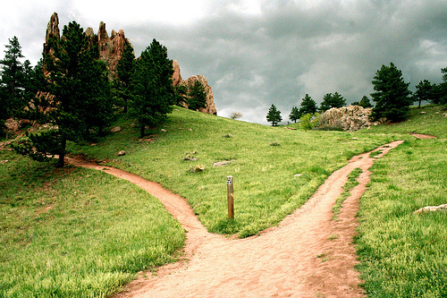
There is another sense in which we glorify or bring glory to God. That is in our daily Christian walk with Him as we make our way toward Heaven. This glorifying leads to our reward in the glory of Heaven if we are faithful. These are the applications of glorify and glory I want to focus on this morning.

Slide 5
Glorify and bring Glory to God in our daily walk:
Matthew 5:14-16, Luke 23:44-47, John 15:5-8
Acts 3:13, 11:18, 12:20-24, 13:44-49
Romans 1:20-21, 3:23, 4:19-25, 5:1-4, 6:3-4, 15:5-7

Slide 6
Christians glorifying God in their daily walk will be rewarded with the glory of Heaven!
Romans 2:7, 10-11, 8:13-18

Slide 7
Do we live our lives giving glory to God?
Are we willing to suffer for Jesus because we know that the sufferings in this life are not worthy to be compared to the glory that shall be revealed to us?
If we are falling short, let us repent and be determined to do better for Him!

Slide 8
The way to start glorifying God is to become a follower of His Son.
Then you will receive honor and glory from the Lord (Revelations 1:4-6).

Slide 9
Why not become a follower of Jesus today?
Please come forward and make your wishes known while we stand and sing!

