Slide 1
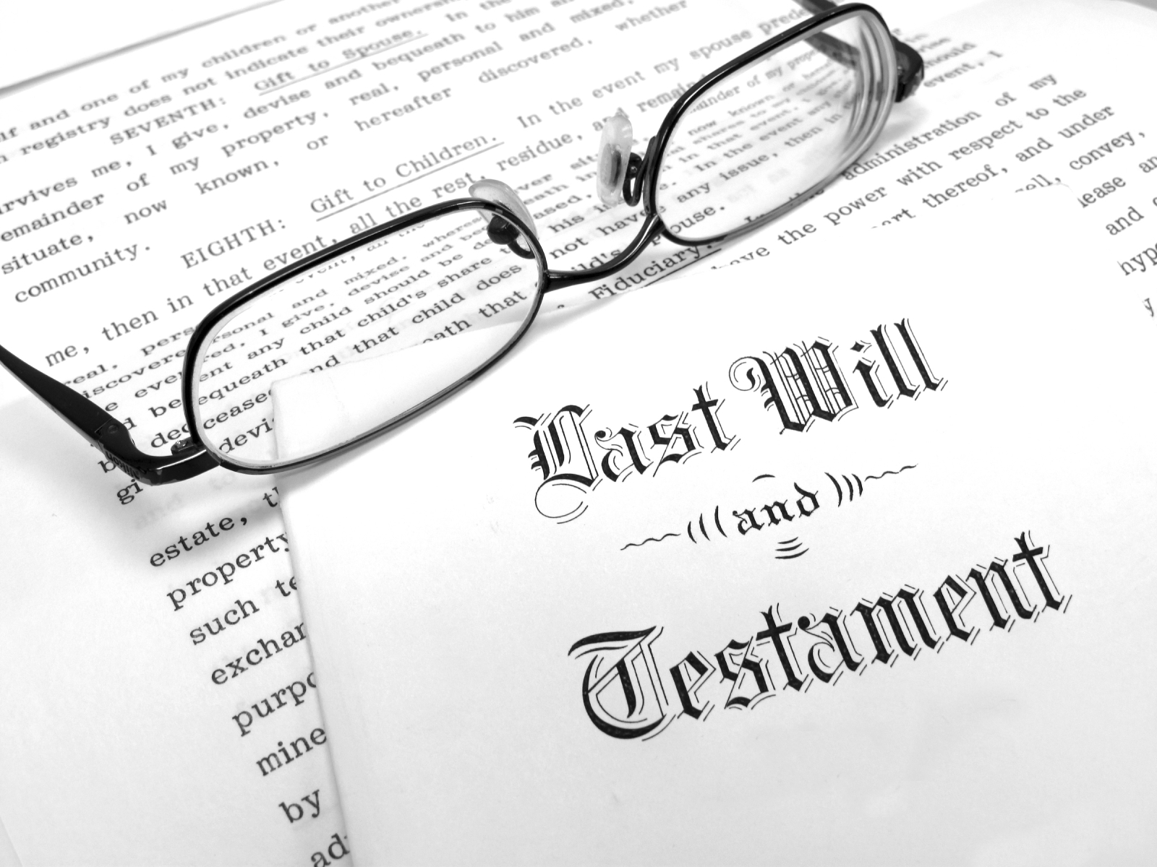
Heirs or Error
Lessons from Jesus’ Last Will & Testament

Slide 2
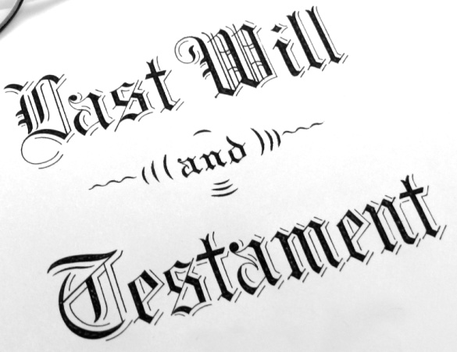
Drafting a Will
What is included?
Any restrictions?
Jesus’ power: Mt. 9:6; Jn. 10:17-18
Conditional inheritance: Ax. 2:38; Rev. 2:10
ERROR: e.g., Predestination; Faith Only; “Once Saved, Always Saved”

Slide 3
Revising a Will
Who may revise? When?
New will invalidates any previous will.
No other gospel: Gal. 1:6-9, 3:15-16
New covenant made old obsolete: Heb. 8:13
ERROR: e.g., Keeping parts of Old Testament; Believing in subsequent revelations

Slide 4
Will Timeframe
Effective date?
Death of our testator Jesus: Heb. 9:16-17
Inter vivos gift: Lk. 23:39-43
ERROR: e.g., Claiming an inter vivos gift that was not given; Inheritance from another testator.

Slide 5
Executing the Will
Who carries out the will’s stipulations?
Any possible challenges?
God is the executor: Rom. 14:10-12; Jn. 6:38
Cannot contest God’s will: Deut. 4:2; Rev. 22:18-19
ERROR: e.g., Proposing a different executor; Contesting God’s will.

Slide 6
Our Inheritance
Heaven: 1 Pet. 1:3-4
Conditions:
If we do His will: Mt. 7:21
Eagerly wait: Heb. 9:27-28
Unrighteous receive no inheritance: 1 Cor. 6:9
Inheritance for God’s children: Jn. 1:12-13; Gal. 3:26-29
ARE YOU AN HEIR?

