Slide 1
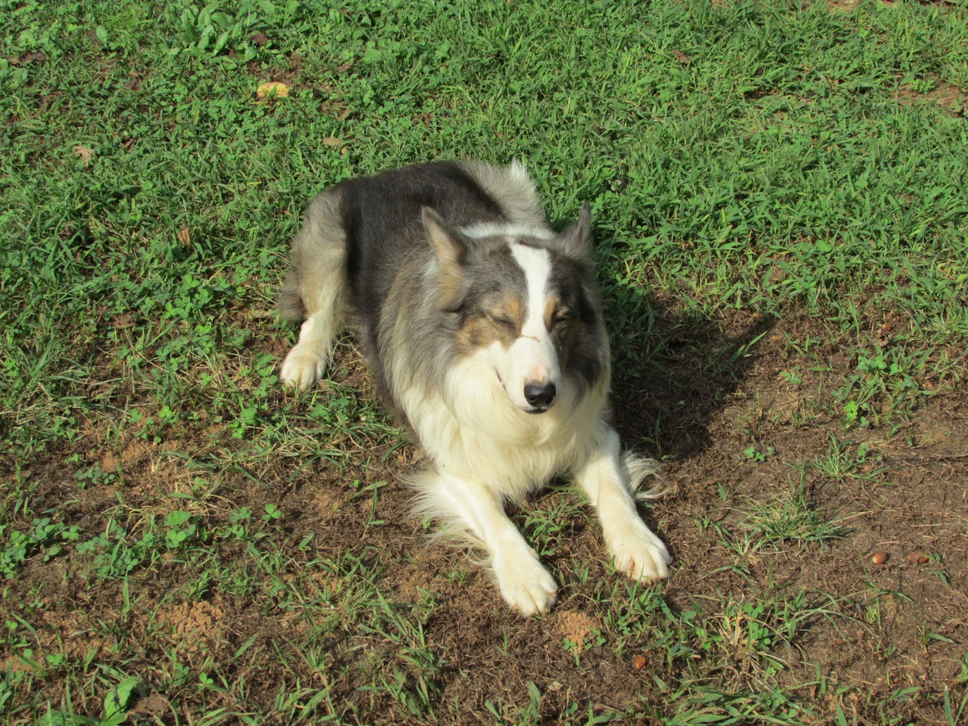
HUMILITY:
HUMBLING OURSELVES TO GOD

Slide 2
HUMILITY
Based on three Greek words related to one another
G5011 (tapeinos) not rising far from the ground metaph. as a condition, lowly, of low degree brought low with grief, depressed lowly in spirit, humble in a bad sense, deporting one's self abjectly, deferring servilely to others;

Slide 3
HUMILITY
Based on three Greek words related to one another
G5012 (tapeinophrosyne) the having a humble opinion of one’s self, a deep sense of one’s (moral) littleness, modesty, humility, lowliness of mind;

Slide 4
HUMILITY
Based on three Greek words related to one another
G5013 (tapeinoo) to make low, bring low, to level, reduce to a plain, to bring into a humble condition, reduce to meaner circumstances, to assign a lower rank or place to, to abase, to be ranked below others who are honoured or rewarded, to humble or abase myself by humble living, to lower, depress, of one’s soul bring down one’s pride, to have a modest opinion of one’s self, to behave in an unassuming manner, devoid of haughtiness

Slide 5
HUMILITY
*The opposite of being haughty
Webster’s defines haughty as being blatantly and disdainfully proud. Other words for haughty could be arrogant, conceited, self-important, snooty, stuck-up, puffed-up, overconfident, superior, and condescending.

Slide 6
HUMILITY
Matthew 18:1-4 (NKJV): At that time the disciples came to Jesus, saying, "Who then is greatest in the kingdom of heaven?" Then Jesus called a little child to Him, set him in the midst of them, and said, "Assuredly, I say to you, unless you are converted and become as little children, you will by no means enter the kingdom of heaven. Therefore whoever humbles himself as this little child is the greatest in the kingdom of heaven.

Slide 7
HUMILITY
Luke 14:11 (NKJV): "For whoever exalts himself will be humbled, and he who humbles himself will be exalted."
Luke 18:13-14 (NKJV): And the tax collector, standing afar off, would not so much as raise his eyes to heaven, but beat his breast, saying, 'God, be merciful to me a sinner!' I tell you, this man went down to his house justified rather than the other; for everyone who exalts himself will be humbled, and he who humbles himself will be exalted."

Slide 8
HUMILITY
Romans 12:16 (NKJV): Be of the same mind toward one another. Do not set your mind on high things, but associate with the humble. Do not be wise in your own opinion.
Ephesians 4:1-3 (NKJV): I, therefore, the prisoner of the Lord, beseech you to walk worthy of the calling with which you were called, with all lowliness and gentleness, with longsuffering, bearing with one another in love, endeavoring to keep the unity of the Spirit in the bond of peace.

Slide 9
HUMILITY
Colossians 2:18-19 (NKJV): Let no one cheat you of your reward, taking delight in [false] humility and worship of angels, intruding into those things which he has not seen, vainly puffed up by his fleshly mind, and not holding fast to the Head, from whom all the body, nourished and nit together by joints and ligaments, grows with the increase that is from God.

Slide 10
HUMILITY
Colossians 3:12-14 (NKJV): Therefore, as [the] elect of God, holy and beloved, put on tender mercies, kindness, humility, meekness, longsuffering; bearing with one another, and forgiving one another, if anyone has a complaint against another; even as Christ forgave you, so you also must do. But above all these things put on love, which is the bond of perfection.

Slide 11
HUMILITY
James 4:6-7 (NKJV) But He gives more grace. Therefore He says: "God resists the proud, But gives grace to the humble." Therefore submit to God. Resist the devil and he will flee from you.
James 4:10 (NKJV) Humble yourselves in the sight of the Lord, and He will lift you up.

Slide 12
HUMILITY
1Peter 5:5-7 (NKJV): Likewise you younger people, submit yourselves to [your] elders. Yes, all of [you] be submissive to one another, and be clothed with humility, for "God resists the proud, But gives grace to the humble”. Therefore humble yourselves under the mighty hand of God, that He may exalt you in due time, casting all your cares upon Him, for He cares for you.

Slide 13
HUMILITY
You may be struggling with humility if:
You rarely or never apologize or admit you are wrong
When you make a mistake, you look for someone else to blame [find a scapegoat (Leviticus 16:8, 10, 26)]
When you are sincerely rebuked, you look for faults in the rebuker
You spend little time actually examining yourself in the mirror
You spend too much time focusing on “your own” accomplishments without giving God the glory
You think about yourself before you think of others
Instead of first admitting your mistake, wrong, or sin, you find yourself making excuses for your behavior
You have trouble thanking others or praising others for their efforts in the Lord
*If some toes are being stepped on, remember mine are there too!

Slide 14
HUMILITY
Let us:
Be quick to admit our faults and to repent
Be thankful when rebuked
Be humble and gentle when rebuking
Look at our own faults first (i.e., the planks) so we can see clearly the faults (i.e., the specks) of others (Matt. 7:1-5)
Not blame others for our mistakes and sins
Remember we are sometimes simply wrong
Realize at best we are unprofitable servants (Luke 17:10)
Be clothed with humility in our lives (1 Peter 5:5)
Realize how we deal with our mistakes, sins, faults, and wrongs reflects on and influences others

Slide 15
HUMILITY
Pride and arrogance are tools of Satan to get us off track of the humility the Lord wants us to live by. Let us remember how the Lord taught us to be servants when He washed the feet of His disciples (John 13:1-17). Jesus says, “But he who is greatest among you shall be your servant. ” (Matthew 23:11).
We all need to be aware of the dangers of losing our humility. Moses was the most humble man to walk this earth, yet in one moment of not hallowing and honoring God in humility he was not permitted to enter the promised land (Numbers 12:3, 20:12).

Slide 16
HUMILITY
Humility is where our life for God truly begins and lives!
God commands His people to be full of humility. When we have that humble spirit, He will lift us up. “Humble yourselves in the sight of the Lord, and He will lift you up” (James 4:10).
Jesus lived humbly to God’s will.
Matthew 11:28-30 (NKJV): Come to Me, all you who labor and are heavy laden, and I will give you rest. Take My yoke upon you and learn from Me, for I am gentle and lowly in heart, and you will find rest for your souls. For My yoke is easy and My burden is light."

Slide 17
HUMILITY
Jesus humbled Himself to God’s will.
Philippians 2:5-11 (NKJV): Let this mind be in you which was also in Christ Jesus, who, being in the form of God, did not consider it robbery to be equal with God, but made Himself of no reputation, taking the form of a bondservant, and coming in the likeness of men. And being found in appearance as a man, He humbled Himself and became obedient to the point of death, even the death of the cross. Therefore God also has highly exalted Him and given Him the name which is above every name, that at the name of Jesus every knee should bow, of those in heaven, and of those on earth, and of those under the earth, and that every tongue should confess that Jesus Christ is Lord, to the glory of God the Father.

Slide 18
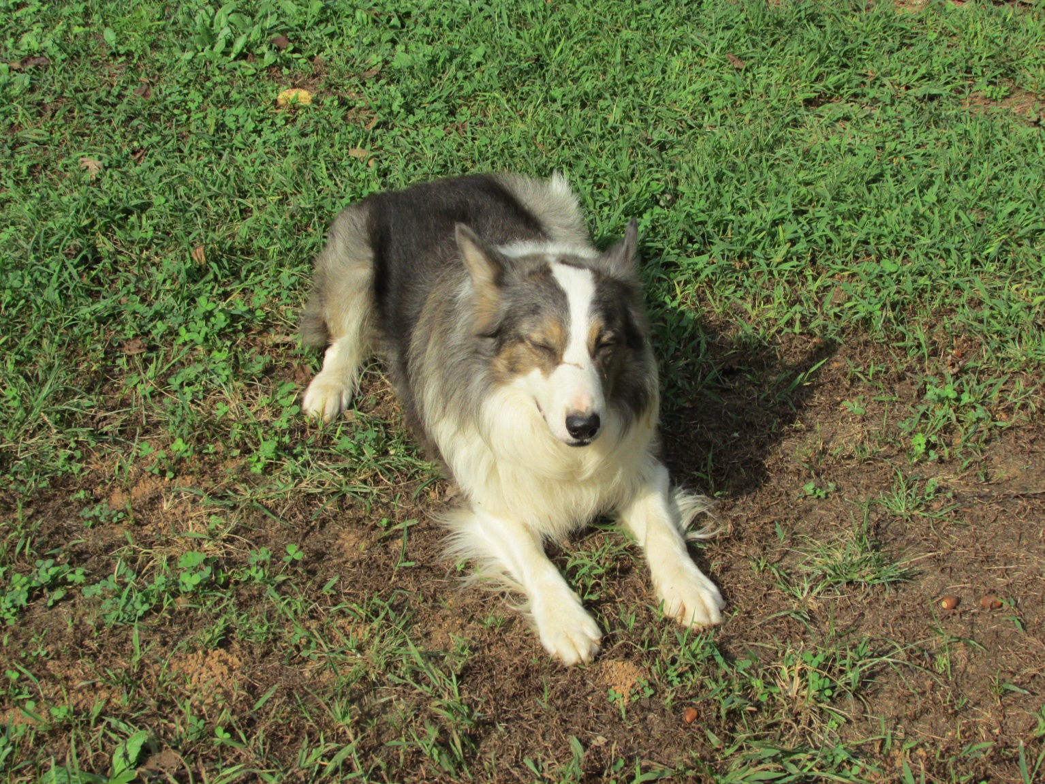
HUMILITY

Slide 19
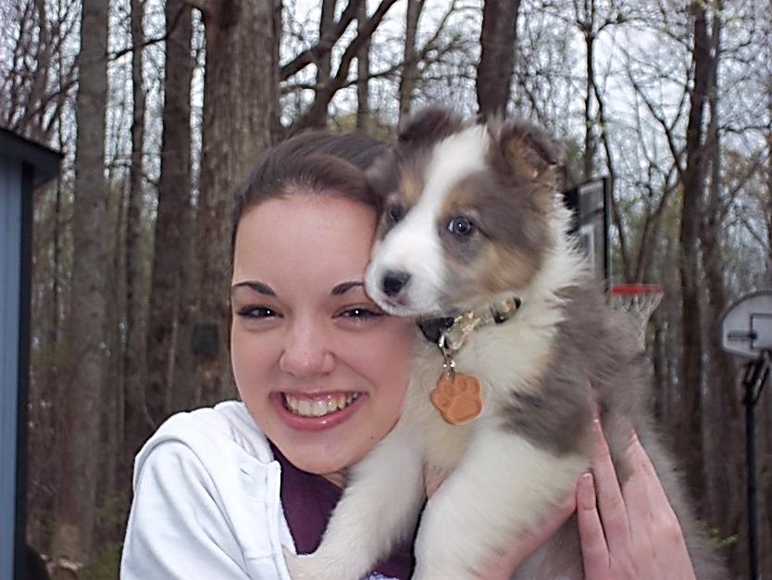
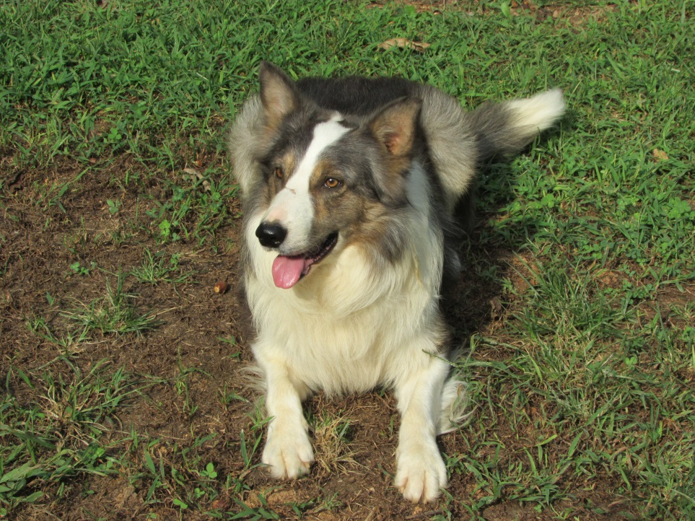
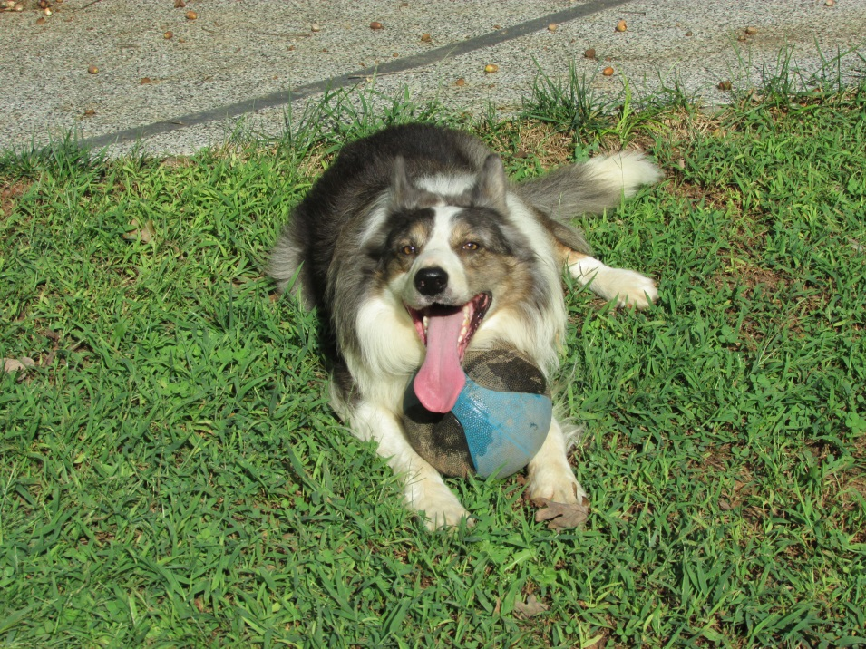

Slide 20
HUMILITY:
HUMBLING OURSELVES TO GOD
True obedience to the Father starts with complete submission and humility, just like we see in Jesus. Yes we have our bad moments, days when we need to repent, times when we get off track, or occasions when we give into Satan’s temptations. However if the desire of our heart is to truly please God, humbling ourselves to Him can help us get better each day! By doing so, we will have much joy in this life and eternal life in the world to come!

