Slide 1
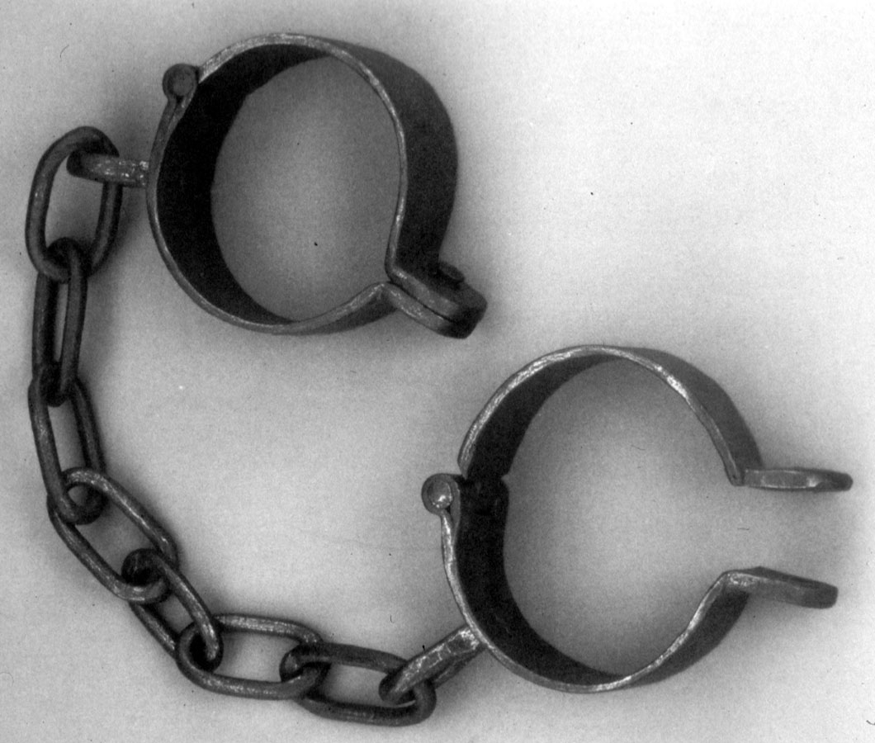
Did the Bible Get Slavery Wrong?
Part 2

Slide 2
Review
Morality of slavery
Hebrew and Greek
Bible slavery ≠ American slavery
Hebrew not enslaved for life
Slavery as a punishment

Slide 3
Slavery during the NT
Rules of slavery not discussed in detail
Eph. 6:5-9, Col. 3:22-25, I Tim. 6:1-2, 13, Titus 2:9-10
  Serve to bring glory to God
  Masters were to treat with respect
  Believing slaves served believing masters
Used as an analogy to compare relationships

Slide 4
We are all Slaves
Either to sin or to Christ
  John 8:33-36, Gal. 5:1, I Cor. 4:1-2
Christ embodied the concept of servitude
  Matthew 20:26-28
  Philippians 2:3-9
Humility results in exaltation
  Matt. 19:29-30
  Mark 10:42-45
A faithful slave brings glory to God
  I Cor. 7:20-23

Slide 5
Philemon
Vs. 1 – Paul the prisoner
Vs. 4-9 – Philemon was an upright man
Onesimus made major changes
Paul asked that Onesimus be received as a brother
God had a plan for Onesimus

