Slide 1
THE ELECTION OF GOD
A while back Kevin presented material on “Predestination” and “Calvinism”. There are many religious people in the world today who believe that God chooses certain favored ones and blesses them with salvation. If you are not one of the “elected” ones, there is no hope that you will ever obtain salvation. This doctrine also promotes the idea that once you are elected, you can do nothing to fall away from grace and lose your salvation.

Slide 2
THE ELECTION OF GOD
This doctrine is not a doctrine of the Bible and did not come into existence until over 1,500 years after Jesus brought His Gospel to man. Man has brought in many of his own ideas into churches in the 2,000 years since Christ. This was predicted in the Bible and should not be a surprise to those of us who are Christians and members of the church Jesus established (2 Peter 2:1-3, 1 John 4:1).

Slide 3
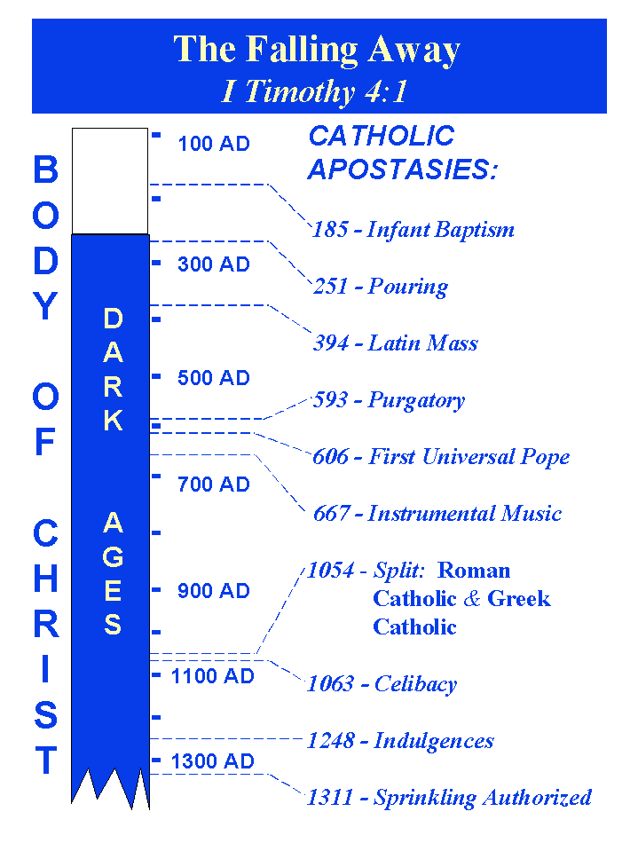

Slide 4
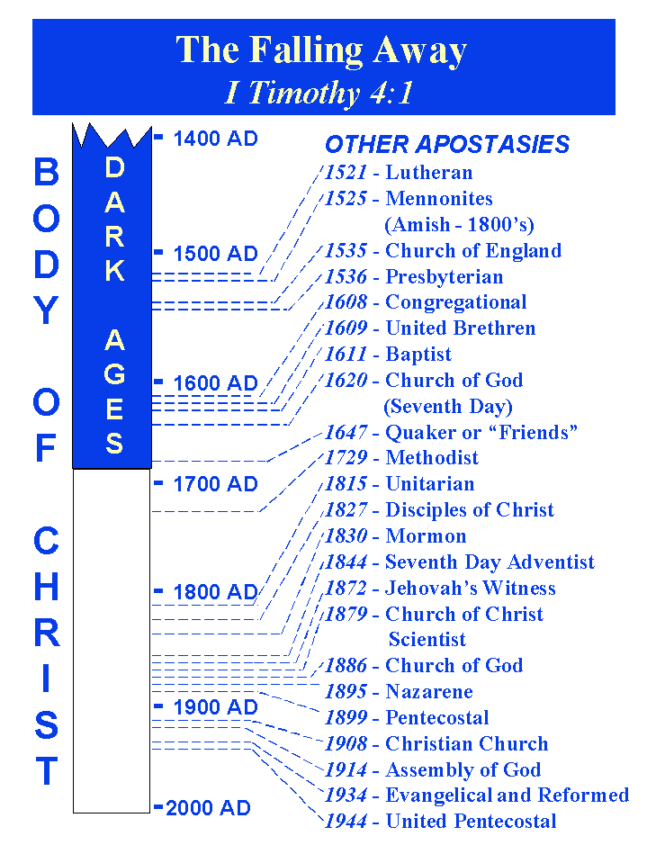

Slide 5
THE ELECTION OF GOD
This chart stops at 1944. Since that time thousands of manmade denominations and churches have come into our world!
This is not what Christ wants and is contrary to the teachings in His gospel
(1 Corinthians 1:10-13, Ephesians 4:1-6).

Slide 6
THE ELECTION OF GOD
The New Testament contains many warnings for His elect to remain faithful and diligent to the end (e.g.,
2 Timothy 2:10-19, Hebrews 4:11, 2 Peter 3:17-18).

Slide 7
THOSE WHO WERE ELECTED IN THE BIBLE
THE NATION OF ISRAEL
1. Israel had a choice to be saved (Acts 3:22-26).
2. The adoption, election, and predestination all applied to the Jews (John 1:11-13, Romans 2:10-11, 9:3-4). However, God required Belief (Romans 2:5-9, 9:33-10:1, 11-12).
3. The Israelite branch was broken off in order that the Gentiles could be grafted in. God could also graft the Israelites back in again (Romans 11:17-24). Gentiles could also be cut off if they did not continue in His goodness (Romans 11:22).

Slide 8
THOSE WHO WERE ELECTED IN THE BIBLE
THE APOSTLES
1. Chosen by Jesus (John 15:16-19, 17:6, Luke 6:13, Acts 1:2-3, 9:15): hand-picked by the Lord.
2. Warnings were given that even applied to the Apostles (Matthew 20:16, 24:14, 22, 24, 31, Mark 13:20, 22, 27). Even the Apostles could fall away (i.e., Judas Iscariot).

Slide 9
THOSE WHO WERE ELECTED IN THE BIBLE
ALL MANKIND
1. The gospel is for all to come to obedience (Acts 10:34-35, 17:30-31, Romans 2:11, 10:13-17).
2. No individual is specified in the election but God wants all to access His grace through faith, that they should walk in His good works and not perish (Romans 5:1-2, Ephesians 2:8-10, 2 Peter 3:9).

Slide 10
CONDITIONS OF BEING ELECTED
1. God grants His grace and mercy to those who fear Him (Matthew 10:28, Luke 1:50, Revelation 19:5).
2. God shows mercy on those who are chosen by Him. God also tells us He chooses those who are obedient (Exodus 20:6, 1 John 5:1-4).

Slide 12
CONDITIONS OF BEING ELECTED
THE ELECT, PREDESTINED, & ADOPTED ARE THOSE WHO HAVE OBEYED GOD AND REMAIN FAITHFUL!
1. Ephesians 1:1-14
2. Romans 8:28-30
3. Luke 18:7
4. Titus 1:1
5. Colossians 3:12-17, 1 Thessalonians 1:2-7
6. 1 Peter 1:1-2:3
7. 1 Peter 2:4-17
8. 2 Peter 1:5-11
9. 2 Thessalonians 2:13-14

Slide 13
THE ELECTION OF GOD
The apostles were commanded to go into all the world and preach the gospel to every creature in order that people would be saved (or elected) (Matthew 28:18-20, Romans 16:25-26, Colossians 1:5-6). Why preach if each person does not have control of their decision to be elected?

Slide 14
THE ELECTION OF GOD
We are chosen based on whether we obey the Word, the gospel (Matthew 7:21-24, James 1:25)! This does not mean that we earn our salvation. God and Jesus Christ paid that price and nothing we can do will pay for the price of sin. But we can obey and gain access to the grace that is offered to us (Romans 5:1-2).

Slide 15
THE ELECTION OF GOD
Many religions today, claim that in their group, certain ones are highly favored and have certain privileges that the normal member does not have. Some have special ones who will go to heaven while others stay on earth. Some have certain officers (presidents, apostles, arch bishops, etc.) who have various privileges above the average members.

Slide 16
THE ELECTION OF GOD
In Christ’s church there are saints, deacons, and bishops, and they all have the same hope for the same reward – to live eternally in heaven.

Slide 17
THE ELECTION OF GOD
God will save the faithful remnant (Romans 9:27, 11:5). They are the ones who are called, chosen, elected, and are faithful (Revelations 17:14). Why not chose to become one of those faithful this morning?

Slide 18
THE ELECTION OF GOD
There is only one way to become one of the elect.
That is by obeying the commands of Jesus. By believing Him, confessing that He is the Son of God, repenting of your sins, and being immersed in the waters of baptism to wash away those sins.

Slide 19
THE ELECTION OF GOD
Then you become one of the elect; a Christian; a follower of Jesus Christ; one who has the hope of eternal life in Heaven.

