Slide 2
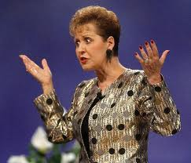
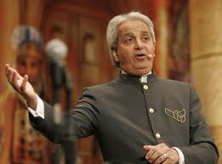
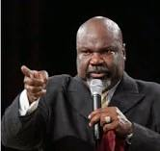
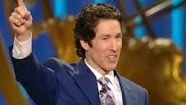
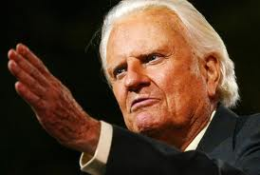
Life
Counselor
Women
Preachers
Faith
Healer
Health
and
Wealth
Preacher
Denominational Doctrine
Preacher

Slide 4
2 Separate Perspectives
The Preacher
The Listener
Sermon preparation
Sermon content
Sermon delivery
Things to look for
Things to expect
Things to demand

Slide 5
Today’s Objectives
Foundational Principles of the Preacher
What He Should Preach
How He Should Preach
When He Should Preach

Slide 6
Today’s Objectives
Foundational Principles of the Preacher
What He Should Preach
How He Should Preach
When He Should Preach

Slide 7
Foundational Principles of the Preacher
To preach is to publicly proclaim
To preach is to teach
A preacher is a public teacher, Jesus was such (Matthew 5-7)
Not everyone should be a preacher (James 3:1)
* Teacher: Didaskalos → Didasko meaning an instructor, master, or teacher
The tongue is difficult to control (v. 2-12)
Those will receive stricter judgment (v. 1)
Many members with different talents (Romans 12:4-8)

Slide 8
Foundational Principles of the Preacher
To preach is to publicly proclaim
To preach is to teach
A preacher is a public teacher, Jesus was such (Matthew 5-7)
Not everyone should be a preacher (James 3:1)
Not everyone can be a preacher
Some people do not have the ability to speak publicly
Some do not have the proper knowledge to instruct (Hebrews 5:12)
Women are not permitted by Scripture to preach
A woman should not have authority over a man (I Timothy 2:12)
Men were given the authority to speak and exhort (Titus 2:15)

Slide 9
Today’s Objectives
Foundational Principles of the Preacher
What He Should Preach
How He Should Preach
When He Should Preach

Slide 10
What He Should Preach
Preach about Jesus Christ
Greeks came wishing to see Jesus (John 12:20-21)
1st sermon recorded of Peter preaching Jesus (Acts 2:14-40)
Peter and John preached Jesus to Sanhedrin (Acts 4:8-12)
Phillip preached Jesus to Ethiopian Treasurer (Acts 8:26-38)
Saul preached Christ in synagogues (Acts 9:20-22)
Peter preached Jesus to house of Cornelius (Acts 10:34-43)

Slide 11
What He Should Preach
Preach about Jesus Christ
Preach about salvation
Peter preached of salvation through Christ (Acts 4:12)
Possessed girl recognized that Paul and Silas preached the way of salvation (Acts 16:17)
The gospel has the power to save! (Romans 1:16)

Slide 12
What He Should Preach
Preach about Jesus Christ
Preach about salvation
Preach about sin
Christians cannot avoid sin if not taught what is sin
Jesus warned the multitudes of sin continually (Matthew 5-7)
Peter told those on Pentecost of their sin (Acts 2)
John the Baptist taught of repentance of sin (Matthew 3:1-12)
Paul instructed Timothy to guard against sins with the Word (II Timothy 3)

Slide 13
What He Should Preach
Preach about Jesus Christ
Preach about salvation
Preach about sin
Preach the Word! (II Timothy 4:2)
Paul charges Timothy with this
Preach the whole gospel as Paul did (Acts 20:27)
Warn of false teachings and dangers (Acts 20:28-31)
Preach the popular and unpopular subjects

Slide 14
What He Should Preach
Preach about Jesus Christ
Preach about salvation
Preach about sin
Preach the Word!
Preach the application
Nehemiah, Ezra, and others taught and made sense of the Law of God (Nehemiah 8:8)
The Preacher of Ecclesiastes gives the conclusion of His book (Ecc. 12:13)
Example: The salt and the light of the earth (Matthew 5:13-16)

Slide 15
Today’s Objectives
Foundational Principles of the Preacher
What He Should Preach
How He Should Preach
When He Should Preach

Slide 16
How He Should Preach
Preach to accomplish goals
Preach to encourage the brethren (II Corinthians 4:16-18)
Preach to instruct (I Timothy 2:8-ff)
Preach to have balance of teachings
Not all hearing are of the same understanding
Not all hearing are dealing with same issues
Preach to know and understand a book or chapter (Ex: II Timothy 3)
Preach to correct any misunderstanding (Acts 17:16-ff)

Slide 17
How He Should Preach
Preach to accomplish goals
Preach with conviction
Be convinced of what you are preaching (Acts 26)
Lack of confidence raises doubt
Preachers must be diligent to erase any doubts (II Timothy 2:15)

Slide 18
How He Should Preach
Preach to accomplish goals
Preach with conviction
Preach with boldness
Peter & John spoke boldly to Sanhedrin (Acts 4:13-22)
They prayed for continued boldness (4:23-30)
Barnabas tells apostles of Saul’s bold preaching in Damascus (Acts 9:27;20-22)
Paul not ashamed of the gospel of Jesus Christ (Romans 1:16)

Slide 19
How He Should Preach
Preach to accomplish goals
Preach with conviction
Preach with boldness
Preach with humility and thankfulness
Even the preachers can sin (I Corinthians 10:12)
Teachers/Preachers will receive stricter judgment (James 3:1)
Do all things with thanks (Colossians 3:17)

Slide 20
How He Should Preach
Preach to accomplish goals
Preach with conviction
Preach with boldness
Preach with humility and thankfulness
Preach to be understood
We pray for this
Message not profitable if can not be understood
Use common words, apostles not very educated (Acts 4:13)
Interpreters were required for those prophesying (I Corinthians 14:13-19)
Be organized
Know what you want the audience to learn

Slide 21
Today’s Objectives
Foundational Principles of the Preacher
What He Should Preach
How He Should Preach
When He Should Preach

Slide 22
When He Should Preach
Preach “in season and out of season”
Be ready at all times (II Timothy 4:2)
Be ready to convince, rebuke, and exhort (v. 2)
Time will come when people will not hear (v. 3)
Peter and John had to speak of the things they had seen and heard (Acts 4:20)
Preach with a fear of God, not men
Man can only hurt this body
God can destroy the soul (Matthew 10:28)
It is God we should obey (Acts 5:29)

Slide 23
What Have We Learned?
Foundational Principles of the Preacher
What He Should Preach
How He Should Preach
When He Should Preach

