Slide 1
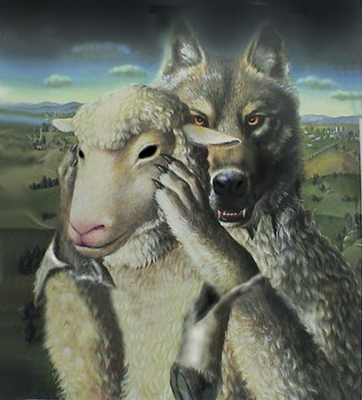
FALSE TEACHERS AND MAGIC CARPETS

Slide 2
“St. Matthew’s Churches”
"Look into Jesus' Eyes you will see they are closed. But as you continue to look you will see His eyes opening and looking back into your eyes. Then go and be alone and kneel on this Rug of Faith or touch it to both knees. Then please check your needs on our letter to you. Please return this Prayer Rug. Do not keep it."

Slide 3
What is False Teaching?
First, we must define TRUTH.
Jn. 14:6; 1 Jn. 5:6; Jn. 8:31-32
Anything outside of truth is FALSE!
TRUTH
NOT TRUTH

Slide 4
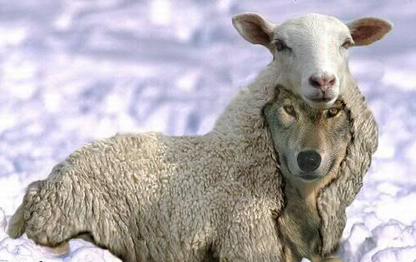
Biblical Examples
The Serpent – Gen. 3:4-5
Nicolaitans – Rev. 2:6, 15-16
Diotrephes – 3 Jn. 9-10
“Many deceivers” – 2 Jn. 7-11

Slide 5
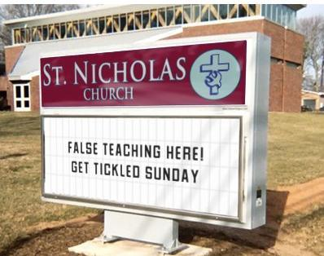
Actions toward False Teachers
Recognize them – Mt. 7:15-20
Identify them – 2 Pet. 2:18-19
Test them – Gal. 1:6-9; 1 Jn. 4:1-6

Slide 6
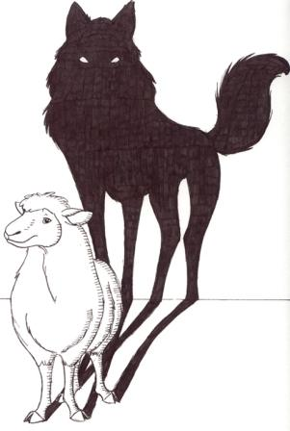
Approaches to Use
Harsh
Jesus – Mt. 23:13
Stephen – Acts 7:51-52
Paul – Acts 23:3
Gentle, Humble, Loving
Paul – Acts 23:5
Gal. 6:1
2 Tim. 2:24-25
Eph. 4:14-15
We must exercise wisdom to know when each method is appropriate – Acts 17:22, 28

Slide 7
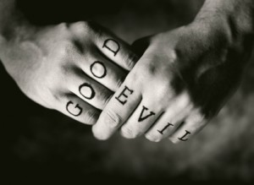
How We Can Confront False Teaching Today
Recognize where it occurs
Choose an appropriate action and Do Something!
Test ourselves

Slide 8
“St. Matthew’s Churches”
"This St. Matthew 18:19 Bible Prayer Rug is soaked with the Power of Prayer for you. Use it immediately, then please return it with your prayer needs checked on our letter to you. It must be mailed to a second home that needs a blessing after you use it. Prayer works. Expect God's blessing."

Slide 9
“St. Matthew’s Churches”
"IMPORTANT - Only break open this sealed prophecy after you have put this church prayer rug and your prayer requests back in the mail to this 60-year-old church ministry. If for any reason you are not going to return this Church Prayer Rug, then this sacred prophecy must be destroyed, unopened, and unread, because this is a sacred, spiritual prophecy, sealed word, concerning you and your future..."

Slide 10
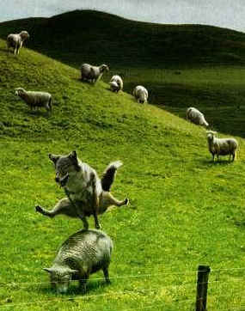
Conclusion
We must read God’s word to discern His will, not look for what we want it to say.
We have a duty to share His word with others who do not know the truth.
Are you abiding in His truth?

