Slide 1
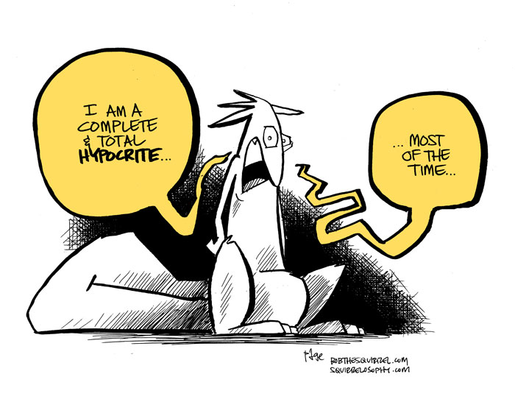
Hypocrisy: Inner Man v. Outward Appearance

Slide 2
Mt. 23:27-28
Woe to you, scribes and Pharisees, hypocrites! For you are like whitewashed tombs which indeed appear beautiful outwardly, but inside are full of dead men’s bones and all uncleanness. Even so you also outwardly appear righteous to men, but inside you are full of hypocrisy and lawlessness.

Slide 3
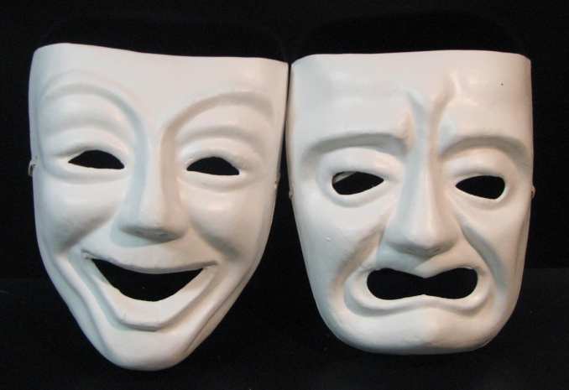
Hypocrite
Derived from Greek word for “Actor”
Playing a part—Acting one way while living a different way on the inside
A person who puts on a false appearance of virtue or religion
One who acts in contradiction to his stated beliefs or feelings

Slide 4
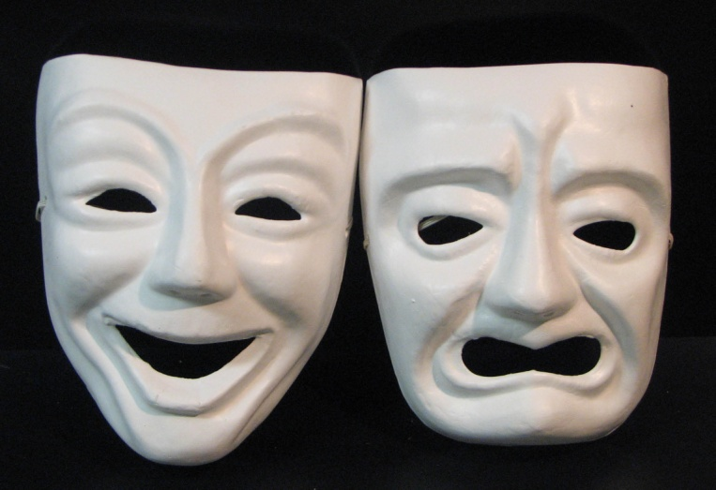
Recent Examples
Ashley Madison users
Racist comments by celebrities
Allegations against Bill Cosby
Various other “scandals” involving politicians & other public figures

Slide 5
Patrick Bateman
High-Paying Job
Beautiful fiancée
Luxury apartment
Social Status
Harvard education
Physically fit
Lacks for nothing materially

Slide 6
Patrick Bateman
No emotion, except for greed, disgust
Superficial; hollow
Materialistic
Finds pleasure only in torturing and murdering others

Slide 7
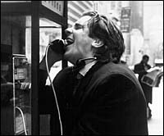
Wants to “Fit In”, Yet Escape
Hides true self from others
Hints at his real character, but others fail to notice
Who are we around others?
Who are we around other Christians?
Are we “Christ-like” at all times?

Slide 8
True Christians can not be hypocritical.
“Fitting in” is conforming to world (Rom. 12:1-2).
We sacrifice our influence (1 Tim. 4:12).
Become like Pharisees (Mt. 23:2-7).

Slide 9
What Does God See?
1 Sam. 16:7 Lord looks at heart.
Prov. 23:7 In his heart
Mt. 15:17-20 Out of the heart…
Mt. 23:26 First cleanse inside

Slide 10
Best of Both Worlds?
Serve 2 masters? Lk. 16:13
Love the world? 1 Jn. 2:15
Light & Darkness? 1 Jn. 1:5-6
WITH GOD, IT IS IMPOSSIBLE TO STRADDLE THE FENCE!!!!

Slide 11
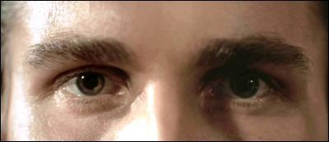
“Inside Doesn’t Matter.”
Inside matters the most.
God knows our hearts.

