Slide 1
Why Are We Different?

Slide 2
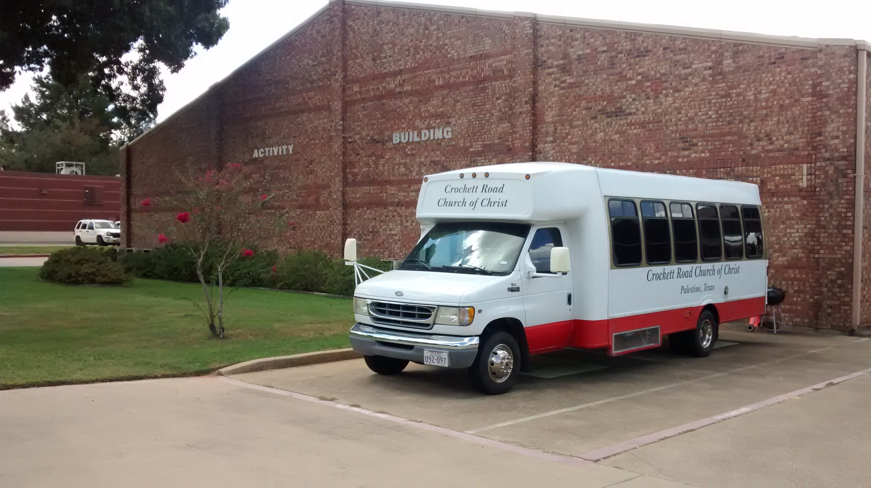
1. THE THINKING OF SOME
Many churches feel that whatever an individual can do, a church can do (e.g., James 1:25-27, 1-2).
Many churches feel if a church thinks something it is a good work, God will allow them to do it, no matter if they see authority from the scriptures or not (Matthew 7:21-24, Ephesians 2:8-10).
Many churches make their primary mission to provide social services to the community (John 4:24, 17:17, Matthew 18:11, 16:26-27, 28:18-20, Acts 2:40-42, Romans 1:16, Ephesians 1:13, 3:8-12, 4:11-16, 1 Timothy 2:3-4, 3:15).

Slide 3
2. WHY DON’T WE?
Why don’t we have church sponsored dances, pool parties, concerts etc.? [Song of Solomon 2:7 (4 times), 1 Peter 4:1-4]
Why don’t we have church sponsored carnivals, raffles, buying and selling of chances, etc.? (1 Corinthians 16:1-2, 1 Timothy 6:6-10)
Why don’t we have church sponsored entertainment such as groups, choirs, bands, or soloists to give concerts during our services or use instruments in our praise of God? (Ephesians 5:18-21, Colossians 3:16-17)

Slide 4
2. WHY DON’T WE?
Why don’t we have a church sponsored daycare facility, bake sales, food pantries, flea markets, trunk or treat, easter egg hunts, Wednesday night spaghetti suppers, blood drives, clothing drives, fellowship halls, social centers, gymnasiums, etc.? (Mark 11:15-17, John 6:26-27, 21:15-17, Mark 14:3-7, Acts 2:44-45, 4:35-38, Romans 14:16-19, 1 Timothy 5:16, 1 Corinthians 11:20-22)

Slide 5
2. WHY DON’T WE?
Why don’t we, the Oak Ridge church of Christ, support man-made organizations? (2 Corinthians 8:1-5, 2 Timothy 2:1-2, Titus 2:1-8, Hebrews 10:24-25)
Why don’t we have an elaborate organization such as other churches? (Philippians 1:1, 1 Peter 5:1-4)
Why don’t we provide financial help from the Oak Ridge treasury to those who are not Christians? (Matthew 25:37-40, Galatians 6:10, 1 Timothy 6:17-19, James 1:25-27)

Slide 6
For those of us who are Christians, let us be content to live within the authority of the New Testament scriptures so that we do not fall away (2 Timothy 4:2-3, 1 Corinthians 15:58, 2 Peter 3:17-18, 2 John 9).

Slide 7
Let us pray for our friends and loved ones who are members of churches practicing things that do not please God. Let us also be motivated to reach out to them with the gospel of Jesus.

Slide 8
We have studied why we of the Oak Ridge church of Christ are different this morning. Being different is not always a bad thing. Being different in the Lord’s church is a very good thing as explained by Peter in 1 Peter 2.

Slide 9
HOW ABOUT YOU THIS MORNING?

