Slide 1
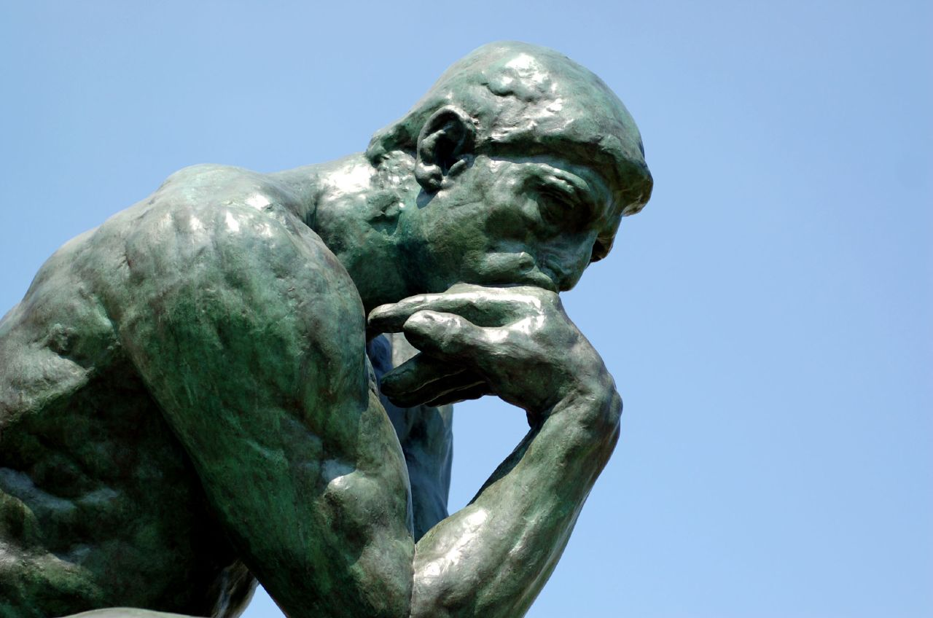
“Behold, I thought…”
2 Kings 5:1-15

Slide 2
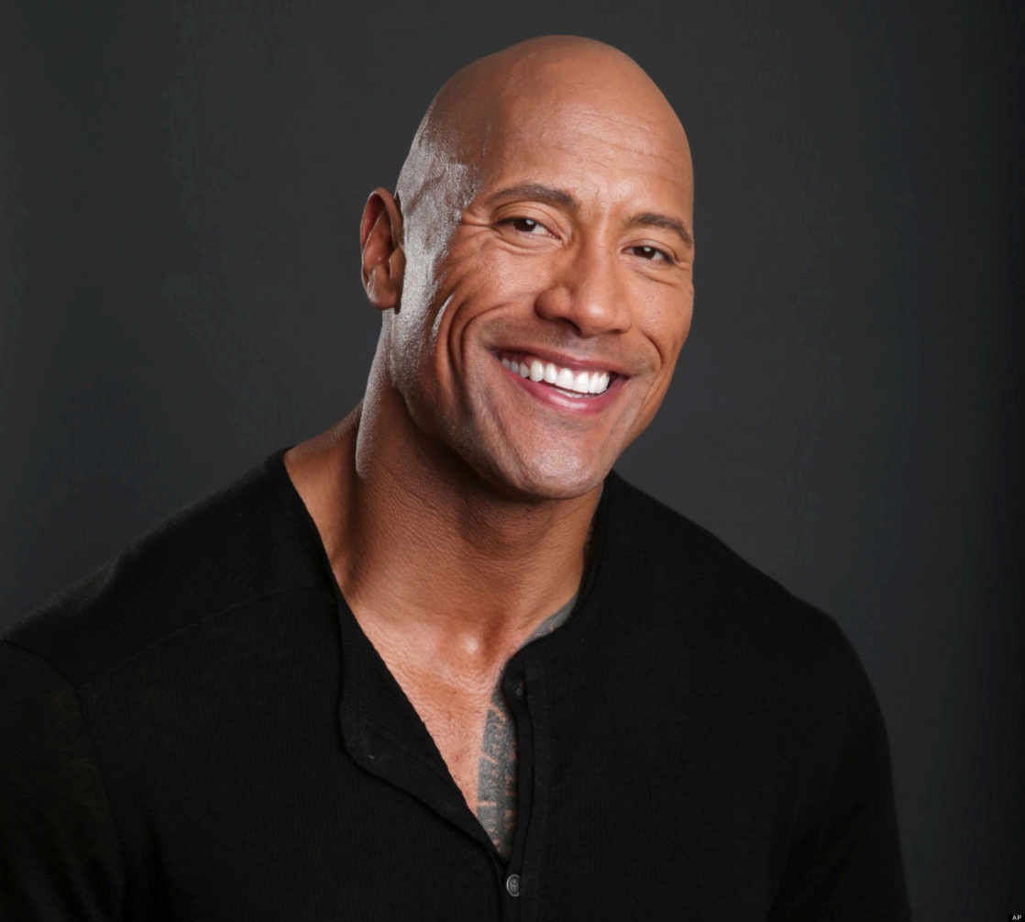

Slide 3
2 Kings 5:1
Naaman
Army commander
Great & honorable man
Mighty man of valor
Lord had given him victories over Israel
BUT, he was a leper
A virtual death sentence, Lk. 4:27

Slide 4
2 Kings 5:2-5
Naaman either…
Showed great faith for a Syrian, or
Was ready to try anything under circumstances
Believed Israelite captive
Showed humility to visit enemy’s prophet

Slide 5
2 Kings 5:9-10
Reception by Elisha
Naaman traveled for miles
Elisha did not even meet him, but instead sent his servant
Go dip in dirty Jordan River

Slide 6
2 Kings 5:11
Naaman’s quote:
“Behold, I thought the prophet would come out and call upon the Lord and strike his hand over me and I would be cleansed of the leprosy.” KJV
“Indeed, I said to myself, ‘He will surely come out to me, and stand and call on the name of the Lord his God, and wave his hand over the place, and heal the leprosy.’” NKJV

Slide 7
2 Kings 5:12-15
Naaman’s reaction:
Furious
Other rivers are better.
Went away in a rage.
Finally listened to his servants

Slide 8
Behold, I Thought
Related Scriptures:
Prov. 3:5-6 Trust in the Lord with all your heart, And lean not on your own understanding; In all your ways acknowledge Him, And He shall direct your paths.
Prov. 14:12 There is a way that seems right to a man, But its end is the way of death.

Slide 9
Behold, I Thought
Related Scriptures:
Is. 55:8-9 “For My thoughts are not your thoughts, Nor are your ways My ways,” says the Lord. “For as the heavens are higher than the earth, So are My ways higher than your ways, And My thoughts than your thoughts.”

Slide 10
Application
We are like Naaman:
Sick with a deadly disease—sin.
Unable to cure it ourselves.
Obedience necessary for successful cure.
Can’t let pride get in the way.

Slide 11
Application
Behold, I thought …
God wants me to be “happy” – Mt. 19:4-9; Heb. 13:4
Worship sounds better with instruments – Eph. 5:19; Col. 3:16
I have plenty of time to obey – Lk. 12:20
I only need to believe – Rom. 10:17; Heb. 11:6; Rom. 10:10; Acts 2:38.

Slide 12
Application
Would Naaman have been healed…
By doing nothing?
By dipping in the rivers of Syria?
By dipping 3 times in the Jordan?
By drinking water from the Jordan?
It doesn’t matter what we think—What matters is what God commands!

