Slide 1
Colossians

Slide 2
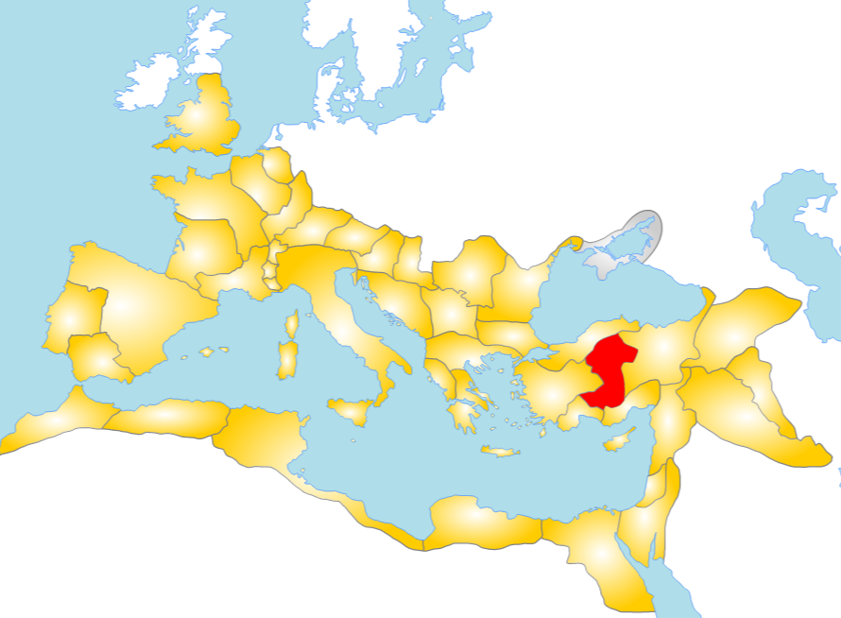
Bithynia
Pontus
Mysia
Phrygia
Cappadocia
Lycaonia(Lycia)
Cilicia
Notes:
Map is Roman provinces 117ad

Slide 3
Written to the church in Colossae
Galatia
Ephesus
Colossae
Notes:
Colossae was a city in Phrygia about 100 miles east of Ephesus.
It was allegedly written around 62-63ad

Slide 4
Why study the Bible like this
Context
The relevance and purpose of the text will be found in the text
Other texts were unlikely available
Copying was labor intensive
Distances made exchanging texts difficult
Some texts literally hadn’t been written and could not be referenced
Texts weren’t meant to be fragmented
These were letters meant to be read in the whole

Slide 5
About Colassae
Paul never personally visited the church there.
“Sister” church with the churches at Laodicea and Hierapolis
A warning against false teachings
Contrasts one living in the flesh against one living in Christ

