Slide 1
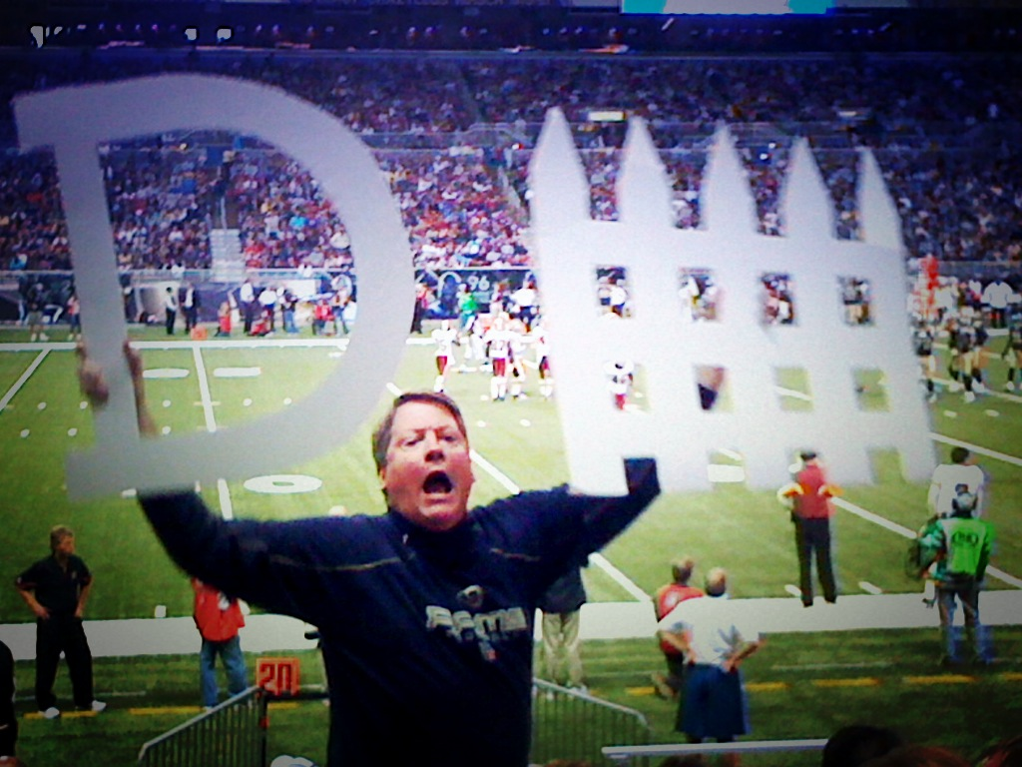
Common Defenses
And Will They Work on
Judgment Day?

Slide 2
Insanity Defense
Insanity – Any mental disorder severe enough that it prevents a person from having legal capacity and excuses the person from criminal or civil responsibility.
One must be “crazy” to knowingly live in sin and ignore God’s commands.
Legion – Mk. 5:1-7, 15, 19-20
Paul – Acts 23:1; 1 Tim. 1:15

Slide 3
Pass the Buck Defense
Blaming parents, spouse, society, etc. for our shortcomings…
“Hey, I’m a child of divorce—gimme a break!”
Each person responsible for own conduct – Ezek. 18:20
Adam & Eve – Gen. 3:11-13
Aaron – Ex. 32:22-24

Slide 4
Silver Rule Defense
Silver Rule – Do unto others as they do unto you.
“But he did it to me first!”
Actions of others do not affect our accountability.
Husband/Wife relationship – Col. 3:18-19
Loving our brethren – Lk. 10:29-35; Heb. 3:13
Disciples abandoned Jesus – Mt. 26:56, 69-74

Slide 5
Machiavellian Defense
The ends justify the means—different circumstances allow for different actions.
When in Rome…
Sin is sin no matter the circumstances.
Abraham – Gen 12:11-19
Saul – 1 Sam. 15:19-23

Slide 6
Ignorance Defense
Failure to know the law.
Ignorance is not a valid defense—if it were, everyone would use it!
Ignorance demands repentance – Acts 3:17-19
Athens – Acts 17:23, 30
Apollos – Acts 18:24-26

Slide 7
Other Defenses
Parable of the Great Supper – Lk. 14:15-24
“Behold, I thought…”
Too busy
Forgot
We’re all guilty – Rom. 3:23

Slide 8
Only One Option
We have no valid defense before God.
Only His grace can save us from a guilty verdict – Rom. 3:24
We must do His will – Mt. 7:21-23
Excuses are in vain – Jn. 15:22

