Slide 1
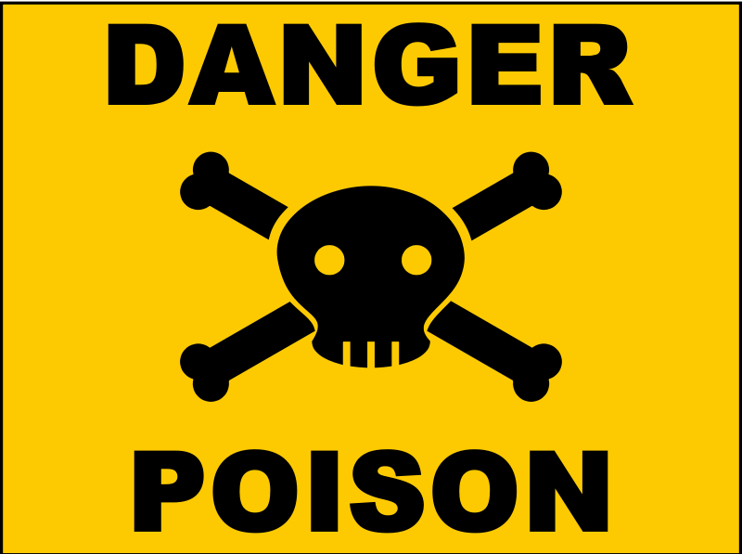
Death in the Pot 2 Kings 4:38-41

Slide 2
2 Kings 4:38-41
Famine in the land
Mistook wild gourds for something good
Gathered a lapful of them for the stew
“There is death in the pot!!!”
Elisha cleansed the stew.

Slide 3
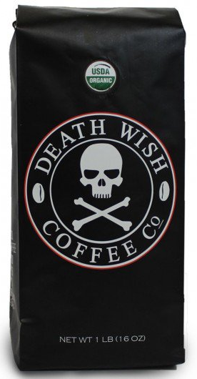
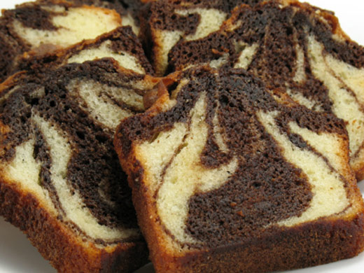
Literally DEATH… in the Pot?

Slide 4
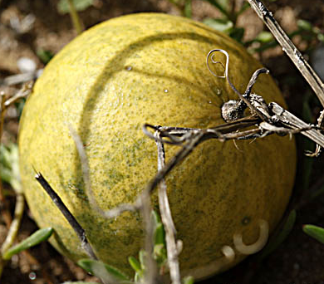
What were these wild gourds?
Possibly Colocynth, aka Bitter Apple, Bitter Cucumber, “Vine of Sodom”
Poisonous, though some benefits are claimed

Slide 5
Parable of Wheat & Tares
Mt. 13:24-30
Similarities:
Difficult to tell the difference until it’s too late—full contamination
Pulling up tares would have uprooted wheat
Main Difference – Who was responsible

Slide 6
Spiritual Application for Us
False teaching in the church – Mt. 7:15-20
Discern between truth & error – Jn. 8:31-32
Feeding on Bread of Life or “devil’s food cake”? – Jn. 6:48-51
Words (idle talk, pointless arguments, etc.) – 2 Tim 2:14-17
Good intentions mixed with ignorance – Acts 17:30

Slide 7
One Antidote for “Death in the Pot”
God’s prophet miraculously cleansed the stew—no other method could save.
“There is a way that seems right to a man, but its end is the way of death.” – Prov. 14:12
To cleanse the death in our pot, we must be obedient. – Titus 3:4-8

