Slide 1
King Mannaseh
2 Kings 21
2 Chronicles 33

Slide 2
Manasseh Facts
12 yrs old when he became king
Reigned 55 years
Lived to be 67 yrs old.
Son of Hezekiah
Father of Amon
Grandfather of Josiah
1st king to rule completely w/out Israel in existence
Believed to have killed Isaiah
Notes:
Manasseh was 12 when he became king. Which as we all know isn’t the youngest but it is one of the youngest. Joash is the famous 7 yr old king and there were two 8 yr old kings (manasseh’s grandson and a puppet king at the very end of Judah’s existence.
Manasseh reigned 55 yrs as king of judah. That’s the longest of any king of either kingdom by quite a bit. There are a few 40 year reigned but none of the others approached 50 yrs. If you do the math that means he lived to be 67 yrs old. Which for the kings of either nation is on the older end.
Major world events during his reign included Assyria being the world power and Israel had been wiped out during his daddy’s reign. So Manasseh begins his kingship knowing that God’s people aren’t invincible.
This one is just conjecture but it’s commonly believed he is the King that Isaiah died under and that he was the prophet that was sawn in half in Heb. 11:37. Isaiah probably did die while Manasseh we in power but there is no evidence Manasseh ever spoke to or had anything to do with Isaiah.
Name means “causing to forget”

Slide 3
Manasseh Facts cont.
He was evil 2 Chronicles 33:2
Like really really evil
Rebuilt high places
Erected altars to Baals
Built altars in the temple
Built altars to the stars and planets in the courtyard
Sacrificed children
Shed so much innocent blood it filled Jerusalem
Omens, sorcery, necromancery, and fortune-telling
Led people to do MORE evil than the nations they destroyed

Slide 4
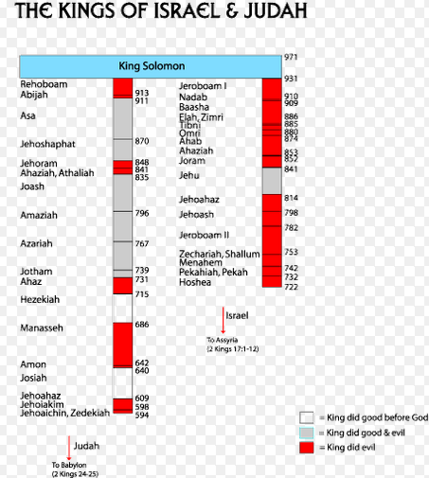
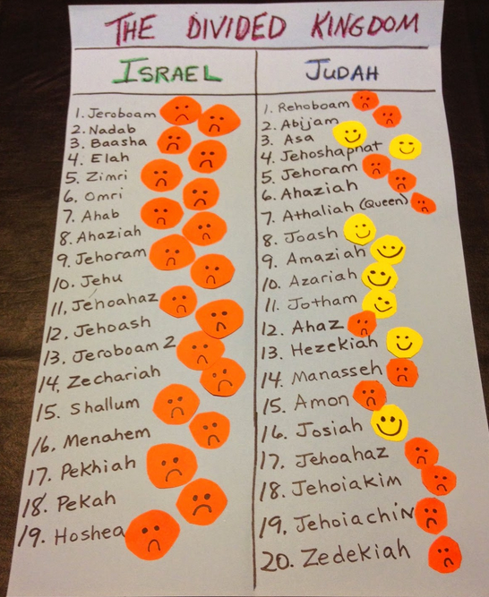

Slide 6
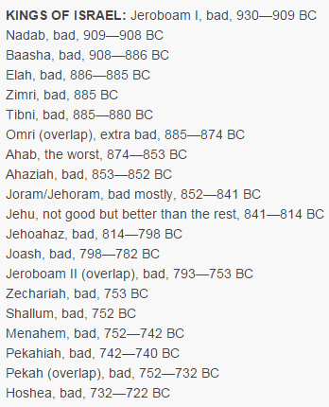
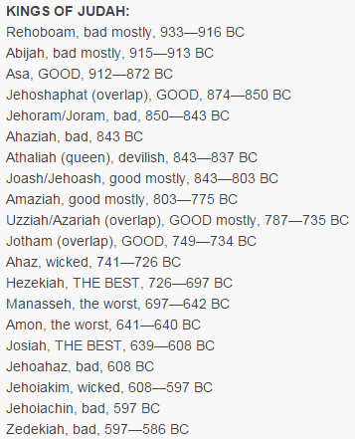

Slide 7
What can we learn from Manasseh?

Slide 8
It doesn’t matter who your daddy was.
Not all good kings had good sons, not all bad kings had bad sons
Manasseh was the son of Hezekiah
Aaron’s sons (Leviticus 10:1-2)
Samuel’s sons (1 Samuel 8:1-4)
David’s sons
Ezekiel 18
A “church of Christ” heritage means nothing
Notes:
Hezekiah is generally regarded as one of the best kings of the united or divided kingdom. He had his flaws but overall he was extremely faithful. With this kind of upbringing you would have thought Manasseh would have started better off.
Unfortunately, the bible is full of examples of sons who didn’t follow in their daddy’s footsteps.
Aaron’s sons were burned up because they brought the false fire to the sacrifice.
Samuel’s sons were so bad that the entire system of judges that Israel had been governed under for generations was thrown aside for a king
David’s family life was full of strife. One son raped his sister, another son murdered the first son then tried to take his dad’s kingdom by force.

Slide 9
The consequences of your sins can outlast you
2 Kings 23:26, 24:3
Manasseh was the final straw, Judah was going to fall
Manasseh’s evil didn’t mean God was punishing those who came after
Josiah reigned 31 yrs and did what was right
Men sinned and now salvation is free to all
Matthew 27:24-26

Slide 10
Manasseh Facts cont.
He was evil 2 Chronicles 33:2
Like really really evil
Rebuilt high places
Erected altars to Baals
Built altars in the temple
Built altars to the stars and planets in the courtyard
Sacrificed children
Shed so much innocent blood it filled Jerusalem
Omens, sorcery, necromancery, and fortune-telling
Led people to do MORE evil than the nations they destroyed

Slide 11
No one is too evil to turn to God
Manasseh facts continued cont.
He was taken into captivity and turned to God
Was taken to Assyria with hooks and chains
He humbled himself greatly before the Lord (Ps. 51:17, 149:4)
God restored him
David (adulterer, liar, conspirator, murderer), Ninevah (Anything imaginable), Paul (persecutor)
Notes:
His captivity by the Assyrians would have happened after Jonah preached in Ninevah and the Assyrians staved off their own destruction.

Slide 12
Your influence can last generations
Hezekiah was Manasseh’s father
Manasseh ultimately turned to God. Why would he do that?
Manasseh was Josiah’s grandfather
Amon reigned 2 years
Josiah was 8 when his father died
Josiah grew up knowing his grandfather turned to God
2 Timothy 1:5
Timothy’s faith was greatly influenced by his grandmother’s
Psalm 92:14-15

