Slide 1
Father’s Day:
Respect for Our Father

Slide 2
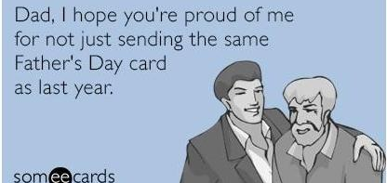
In many ways, Father’s Day has become a joke—a time to mock dads for faults like naps on the couch, avoiding work, alcoholism, and bathroom humor.
Is this just today’s humor or something deeper?

Slide 3
Much of this lack of respect may be light-hearted, good-natured, and indicative of the differences between men and women in our society.
Some of it is deserved.
But does it help make our society better or worse?

Slide 4
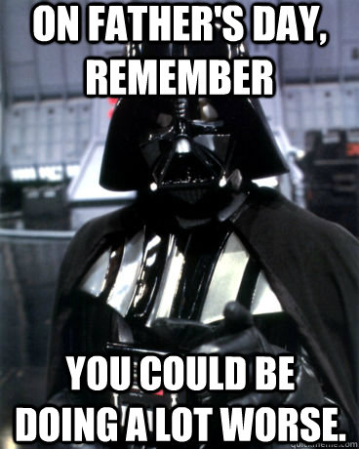
Fathers and mothers are worthy of honor and respect – Eph. 6:1-3.
Therefore, parents should act honorable so they are worthy of such respect.
How much more should we show respect to our Heavenly Father? 1 Pet. 2:17

Slide 5
How Can We Show Respect for God?
In Our Daily Lives…
Obedience – Eccl. 12:13; Heb. 12:7-9, 28
Examine ourselves – 2 Cor. 13:5
How we speak
Blasphemy & using His name in vain – Ex. 20:7; Mt. 12:36
Wholesome language – Prov. 15:1-4; Col. 3:8
Tactful speech – Col. 4:6

Slide 6
How Can We Show Respect for God?
In Our Worship…
Worship – Jn. 4:24; Ps. 76:7, 89:7
Give attention to the public reading of Scripture – 1 Tim. 4:13
How we act – worshiping in spirit implies focus & concentration
How we dress – what is “appropriate”

Slide 7
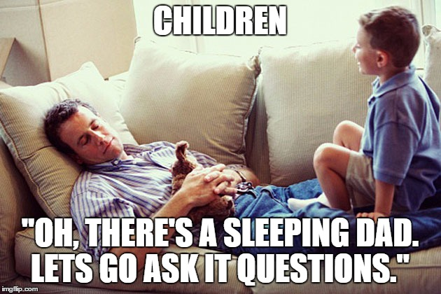
How Can We Show Respect for God?
Many in our society show no respect for God, as evidenced by their actions.
Let us endeavor to always honor God.
Command
For our sakes
Set example

