Slide 1
The Bible
Our State Book, or a Book for the State We’re In…

Slide 2
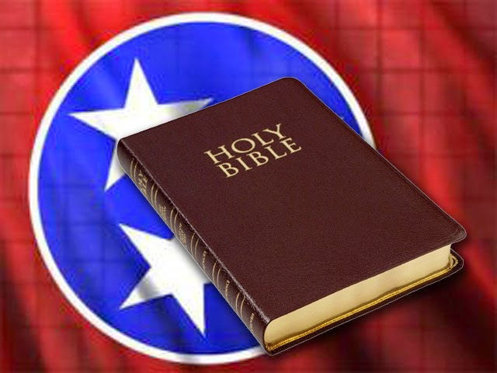
Tennessee HB 615
Proposed language: Tennessee Code Annotated, Title 4 , Chapter 1, Part 3, is amended by adding the following language as a new section: The Holy Bible is hereby designated as the official state book.
4-15-2015: Passed House 55-38-3.
4-4-2016: Passed Senate 19-8-3.
4-14-2016: Vetoed by Governor.
“This bill trivializes the Bible, which I believe is a sacred text.”
Also questions about its constitutionality…

Slide 3
Current Tennessee State Symbols
State Flag…
State Songs – 9 different songs
State tree – Tulip Poplar
State rock – Limestone
State poem – “Oh Tennessee, My Tennessee”
State slogan – “Tennessee—America at Its Best”
State wild flowers – Passion flower and TN Echinacea
State cultivated flower – Iris
State insects – Firefly, Ladybug, and Honeybee
State gem – Tennessee Pearl
State folk dance – Square dance

Slide 4
Current Tennessee State Symbols
State seal…
State theatre – Tennessee Theatre
State game bird – Bobwhite Quail
State butterfly – Zebra Swallowtail
State reptile – Eastern Box Turtle
State sport fish – Small-Mouth Bass
State commercial fish – Channel Catfish
State motto – “Agriculture and Commerce”
State amphibian – Tennessee Cave Salamander
State horse – Tennessee Walking Horse
State beverage - Milk

Slide 5
Current Tennessee State Symbols
State fruit – Tomato
State bird – Mockingbird
State wild animal - Raccoon
State artifact – Sandstone statue “Sandy”
State evergreen tree – Eastern Red Cedar
State rifle – Barrett Model M82/M107
State pets – Dogs & cats adopted from TN animal shelters…
Porcelain painting is recognized as a fine art.
Others: tartan, mineral, aviation hall of fame, railroad museum, railroad library, botanical garden, fife & drum corps

Slide 6
Basic Points about the Bible
2 Tim. 3:14-16
Requires study
Make us wise for salvation through our faith
Inspired by God
Profitable (regardless of its “official” status) for doctrine, reproof, correction, instruction in righteousness
Completes man, thoroughly equipping us for every good work
Jn. 17:14-16 – God’s word yields hate from the world.
Jn. 17:17 – God’s word is Truth.
Rom. 15:4 – Produces hope

Slide 7
Bible v. Government
We are subject to governing authorities – Rom. 13:1.; 1 Pet. 2:13-14.
Govt. is a terror to evil because anarchy would allow evil to operate without consequences – Rom. 13:3.
However, if federal/state/local laws ever conflict with God’s laws, we must choose. Acts 4:19-20; 5:28-29.
God does not need a government’s “help” for anything – Acts. 17:25.

Slide 8
Impact of HB 615’s Defeat
Negligible!
Bible’s authority & power is not diminished at all by not being named Tennessee’s state book.
Bible does not need to be Tennessee’s state book in order for us to obey God’s instructions and preach to others.
Bible does not need rubber stamp from any earthly government. Dan. 2:44, 7:14; Jn. 18:35-37
Don’t be upset – Jn. 14:27-28
We still enjoy the freedom in this country to worship God as He commanded

