Slide 1
The Christian Approach toward Sin

Slide 2
Current Events
Bruce Jenner “transformation”
Duggar family
Supreme Court ruling on gay marriage
Businesses being boycotted for stances on gay marriage

Slide 3
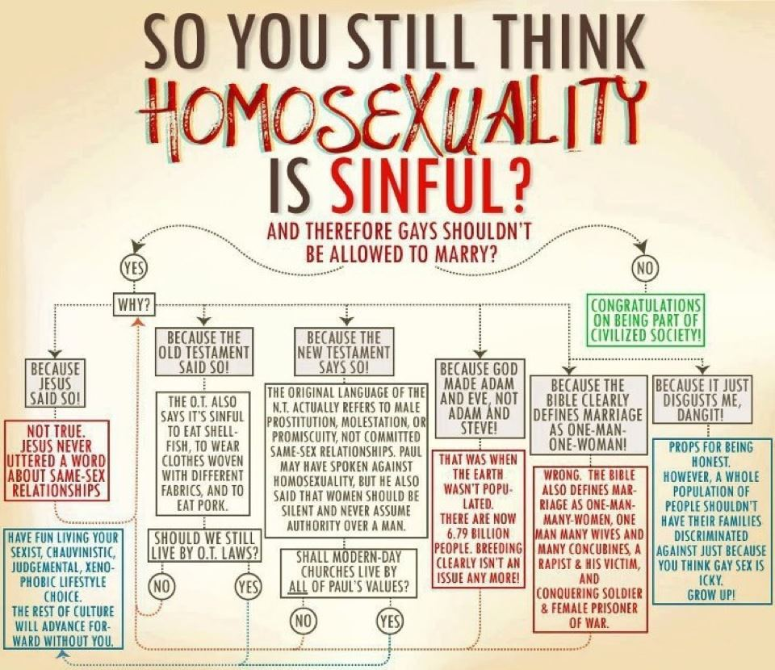

Slide 4
The Typical Gut Reaction…

Slide 5
It’s easy to point out sin
God created male/female – Gen. 1:27; Mt. 19:4-6
Sex is reserved for marriage – Heb. 13:4
Marriage = 1 man & 1 woman – 1 Cor. 7:2
Divorce permitted only under certain conditions – Mt. 19:9; 1 Cor. 7:10-11
But what is our attitude when we do??

Slide 7
How do we react?
Do we elevate certain sins over others?
Rom. 1:26-32; Rom. 3:23; 2 Cor. 5:9-10
Do we speak the truth in love?
Eph. 4:15
Are we hypocrites?
Mt. 7:3-5; Mt. 23:27-28

Slide 8
Christians should reflect Christ’s example
Follow after God
Jn. 6:38
Encourage others to turn from sin
Mt. 9:12-13
Attitude of humility
Phil. 2:1-11

Slide 9
Conclusion
Sin separates Man from God.
If we use the wrong approach, we can kill our influence and end any possibility of teaching.
Col. 4:6 “Let your speech always be with grace, seasoned with salt, that you may know how you ought to answer each one.”

Slide 10
Conclusion
1 Pet. 3:15-16 “But sanctify the Lord God in your hearts, and always be ready to give a defense to everyone who asks you a reason for the hope that is in you, with meekness and fear;

