Slide 1
GET BEHIND ME SATAN!
Here are examples of how having the sun at your back helps see things the way they really are.

Slide 10
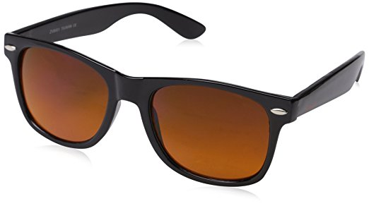
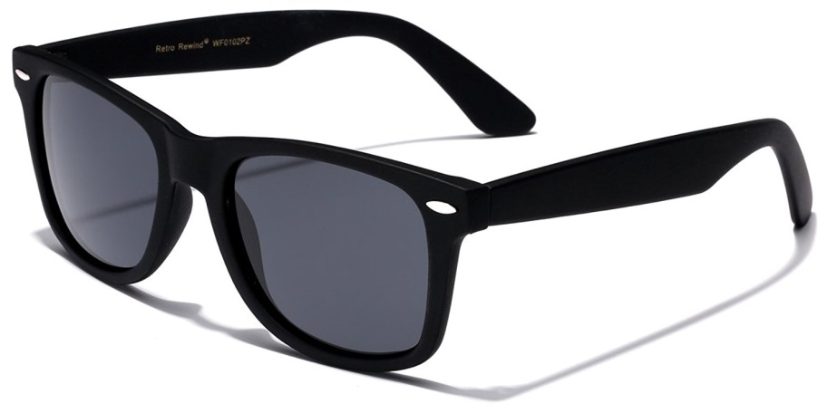
GET BEHIND ME SATAN!
The best glasses are those that are the clearest and show things as they really are.

Slide 11
GET BEHIND ME SATAN!
Satan tried to get the Lord to see things his way in Luke 4:1-13

Slide 12
Luke 4:1-4 (NKJV): Then Jesus, being filled with the Holy Spirit, returned from the Jordan and was led by the Spirit into the wilderness, being tempted for forty days by the devil. And in those days He ate nothing, and afterward, when they had ended, He was hungry. And the devil said to Him, "If You are the Son of God, command this stone to become bread." But Jesus answered him, saying, "It is written, 'Man shall not live by bread alone, but by every word of God.' " Then the devil, taking Him up on a high mountain, showed Him all the kingdoms of the world in a moment of time.

Slide 13
Luke 4:5-13: And the devil said to Him, "All this authority I will give You, and their glory; for this has been delivered to me, and I give it to whomever I wish. Therefore, if You will worship before me, all will be Yours." And Jesus answered and said to him, "Get behind Me, Satan! For it is written, 'You shall worship the LORD your God, and Him only you shall serve.' " Then he brought Him to Jerusalem, set Him on the pinnacle of the temple, and said to Him, "If You are the Son of God, throw Yourself down from here. For it is written: 'He shall give His angels charge over you, To keep you,' "and, 'In their hands they shall bear you up, Lest you dash your foot against a stone.' " And Jesus answered and said to him, "It has been said, 'You shall not tempt the LORD your God.' " Now when the devil had ended every temptation, he departed from Him until an opportune time.

Slide 14
GET BEHIND ME SATAN!
1 John 2:15-17
Do not love the world or the things in the world. If anyone loves the world, the love of the Father is not in him. For all that is in the world--the lust of the flesh, the lust of the eyes, and the pride of life--is not of the Father but is of the world. And the world is passing away, and the lust of it; but he who does the will of God abides forever.

Slide 15
GET BEHIND ME SATAN!
Now let us consider some common situations when we need to get Satan behind us!

Slide 16
GET BEHIND ME SATAN!
When we are tempted to have a worldly physical focus rather than a spiritual focus

Slide 17
GET BEHIND ME SATAN!
Matthew 14:26-31 And when the disciples saw Him walking on the sea, they were troubled, saying, "It is a ghost!" And they cried out for fear. But immediately Jesus spoke to them, saying, "Be of good cheer! It is I; do not be afraid." And Peter answered Him and said, "Lord, if it is You, command me to come to You on the water." So He said, "Come." And when Peter had come down out of the boat, he walked on the water to go to Jesus. But when he saw that the wind was boisterous, he was afraid; and beginning to sink he cried out, saying, "Lord, save me!" And immediately Jesus stretched out His hand and caught him, and said to him, "O you of little faith, why did you doubt?"

Slide 18
GET BEHIND ME SATAN!
Matthew 16:21-23 From that time Jesus began to show to His disciples that He must go to Jerusalem, and suffer many things from the elders and chief priests and scribes, and be killed, and be raised the third day. Then Peter took Him aside and began to rebuke Him, saying, "Far be it from You, Lord; this shall not happen to You!" But He turned and said to Peter, "Get behind Me, Satan! You are an offense to Me, for you are not mindful of the things of God, but the things of men."

Slide 19
GET BEHIND ME SATAN!
Mark 10:21-22 Then Jesus, looking at him, loved him, and said to him, "One thing you lack: Go your way, sell whatever you have and give to the poor, and you will have treasure in heaven; and come, take up the cross, and follow Me." But he was sad at this word, and went away sorrowful, for he had great possessions.

Slide 20
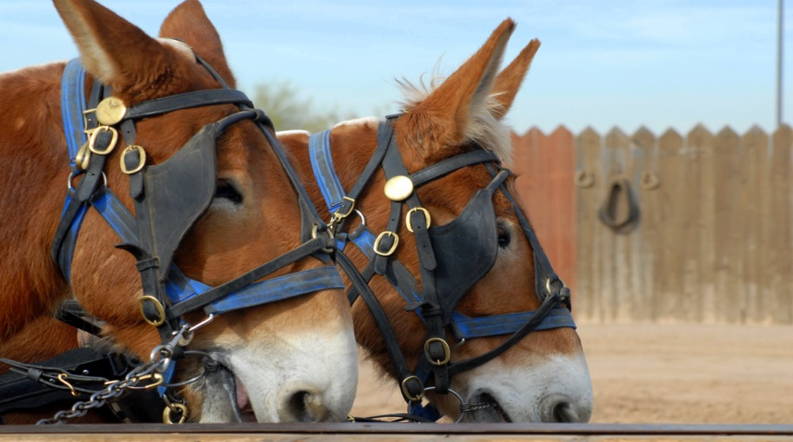
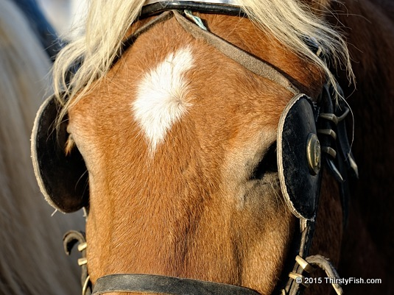
GET BEHIND ME SATAN!
We need to keep the Lord’s blinders on our eyes and our hearts!

Slide 21
GET BEHIND ME SATAN!
When we are tempted to have a worldly physical focus rather than a spiritual focus
When folks do not want to study

Slide 22
GET BEHIND ME SATAN!
Hebrews 10:24-25 And let us consider one another in order to stir up love and good works, not forsaking the assembling of ourselves together, as is the manner of some, but exhorting (encouraging-ESV) one another, and so much the more as you see the Day approaching.

Slide 23
GET BEHIND ME SATAN!
2 Peter 3:17-18 You therefore, beloved, since you know this beforehand, beware lest you also fall from your own steadfastness (lose your own stability-ESV), being led away with the error of the wicked; but grow in the grace and knowledge of our Lord and Savior Jesus Christ. To Him be the glory both now and forever. Amen.

Slide 24
GET BEHIND ME SATAN!
The early disciples experienced the same trials and found comfort in assembling with one another

Slide 25
GET BEHIND ME SATAN!
Early Disciples found comfort in assembling
Acts 2:41-42 Then those who gladly received his word were baptized; and that day about three thousand souls were added to them. And they continued steadfastly in the apostles' doctrine and fellowship, in the breaking of bread, and in prayers.
Acts 5:41-42 So they departed from the presence of the council, rejoicing that they were counted worthy to suffer shame for His name. And daily in the temple, and in every house, they did not cease teaching and preaching Jesus as the Christ.
Acts 16:40 So they went out of the prison and entered the house of Lydia; and when they had seen the brethren, they encouraged them and departed.

Slide 26
GET BEHIND ME SATAN!
When we are tempted to have a worldly physical focus rather than a spiritual focus
When folks do not want to study
When our jobs are not going well

Slide 27
GET BEHIND ME SATAN!
Be thankful we have a job
Psalm 128:2 When you eat the labor of your hands, You shall be happy, and it shall be well with you.
Proverbs 13:11 Wealth gained by dishonesty [hastily (by fraud)-ESV] will be diminished, But he who gathers by labor (little by little-ESV) will increase. Proverbs 14:23 In all labor there is profit, But idle chatter leads only to poverty. Matthew 6:33 But seek first the kingdom of God and His righteousness, and all these things shall be added to you.

Slide 28
GET BEHIND ME SATAN!
Instead of spending time fretting about our job, we can use that time to shine the light of Jesus more. Remember Joseph in prison (Genesis 39:21-23) and Paul and Silas singing while in chains (Acts 16:25)?

Slide 29
GET BEHIND ME SATAN!
Genesis 39:21-23 But the LORD was with Joseph and showed him mercy, and He gave him favor in the sight of the keeper of the prison. And the keeper of the prison committed to Joseph's hand all the prisoners who were in the prison; whatever they did there, it was his doing.
The keeper of the prison did not look into anything that was under Joseph's authority, because the LORD was with him; and whatever he did, the LORD made it prosper.
Acts 16:25 But at midnight Paul and Silas were praying and singing hymns to God, and the prisoners were listening to them.

Slide 30
GET BEHIND ME SATAN!
Now let us notice what Paul says:

Slide 31
GET BEHIND ME SATAN!
Philippians 2:14-16 Do all things without complaining and disputing (grumbling or arguing), that you may become blameless and harmless, children of God without fault in the midst of a crooked and perverse generation, among whom you shine as lights in the world, holding fast the word of life, so that I may rejoice in the day of Christ that I have not run in vain or labored in vain.

Slide 32
GET BEHIND ME SATAN!
Colossians 3:22-25 Bondservants, obey in all things your masters according to the flesh, not with eyeservice, as men-pleasers, but in sincerity of heart, fearing God. And whatever you do, do it heartily (work heartily-ESV), as to the Lord and not to men, knowing that from the Lord you will receive the reward of the inheritance; for you serve the Lord Christ. But he who does wrong will be repaid for what he has done, and there is no partiality.

Slide 33
GET BEHIND ME SATAN!
When we are tempted to have a worldly physical focus rather than a spiritual focus
When folks do not want to study
When our jobs are not going well
When loved ones are far away

Slide 34
GET BEHIND ME SATAN!
Rejoice we have a Father we can to pray to
Philippians 4:6-7 Be anxious for nothing, but in everything by prayer and supplication, with thanksgiving, let your requests be made known to God; and the peace of God, which surpasses all understanding, will guard your hearts and minds through Christ Jesus.

Slide 35
GET BEHIND ME SATAN!
Rejoice we have a Savior who always stands by us
2 Timothy 4:16-18 At my first defense no one stood with me (came to stand by me-ESV) , but all forsook (deserted-ESV) me. May it not be charged against them. But the Lord stood with me and strengthened me, so that the message might be preached fully (fully proclaimed-ESV) through me, and that all the Gentiles might hear. And I was delivered (rescued-ESV) out of the mouth of the lion. And the Lord will deliver (rescue-ESV) me from every evil work and preserve me for (bring me safely into-ESV) His heavenly kingdom. To Him be glory forever and ever. Amen!

Slide 36
GET BEHIND ME SATAN!
Rejoice we have a Savior who will never leave us
Hebrews 13:5-6 Let your conduct be without covetousness (keep your life free of the love of money-ESV); be content with such things as you have. For He Himself has said, "I will never leave you nor forsake you." So we may boldly say: "The LORD is my helper; I will not fear. What can man do to me?"

Slide 37
GET BEHIND ME SATAN!
Rejoice we have our Christian family
Matthew 12:47-50 Then one said to Him, "Look, Your mother and Your brothers are standing outside, seeking to speak with You." But He answered and said to the one who told Him, "Who is My mother and who are My brothers?" And He stretched out His hand toward His disciples and said, "Here are My mother and My brothers! For whoever does the will of My Father in heaven is My brother and sister and mother."

Slide 38
GET BEHIND ME SATAN!
If we can get Satan behind us, we will see the potential for good that the Lord wants us to see rather than the discouragement Satan wants us to focus on. God has given Christians many things to look forward to and a wonderful outlook for our lives. Let us be determined, like Jesus, to put Satan behind us! We will see things in the best possible light and be more productive for Him. Then we will be able to clearly see the path the Lord has for us that avoids spiritual danger and leads to eternal life!

Slide 39
GET BEHIND ME SATAN!
Matthew 7:13-14
"Enter by the narrow gate; for wide is the gate and broad is the way that leads to destruction, and there are many who go in by it. Because narrow is the gate and difficult is the way which leads to life, and there are few who find it.

Slide 42
GET BEHIND ME SATAN!
If you are not a child of God tonight, your outlook for the future is very grim.
Why not get Satan behind you today?
He wants you to be content in your sins.
Why not come to Jesus and repent and be baptized to wash away those sins that hinder you?
And get Satan behind you for good!

Slide 43
GET BEHIND ME SATAN!
If we can help you now, please let us know while we stand and while we sing!

