Slide 2
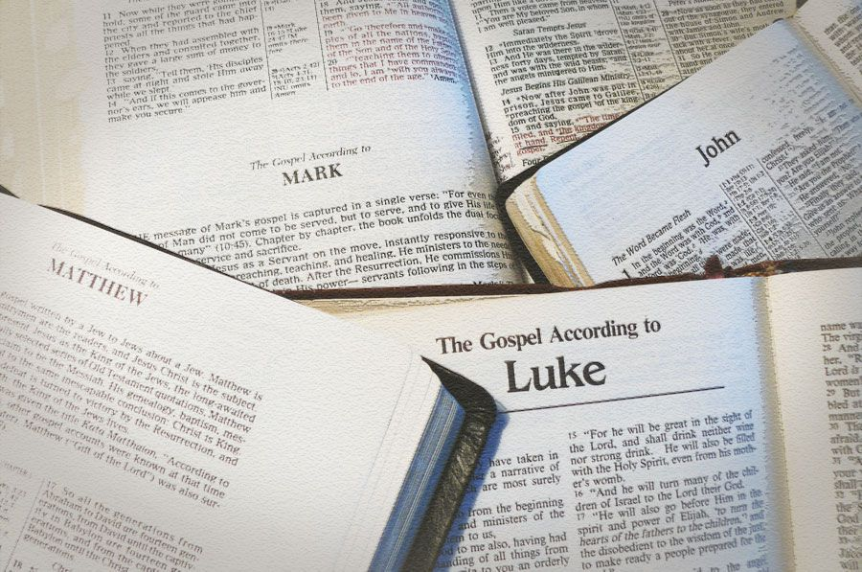
Why do we have 4 gospel accounts?

Slide 3

What are the gospels?
“Inasmuch as many have undertaken to compile an account of the things accomplished among us, just as they were handed down to us by those who from the beginning were eyewitnesses and servants of the word, it seemed fitting for me as well, having investigated everything carefully from the beginning, to write it out for you in consecutive order, most excellent Theophilus; so that you may know the exact truth about the things you have been taught.”
  Luke 1:1-4
“The first account I composed, Theophilus, about all that Jesus began to do and teach, until the day when He was taken up to heaven, after He had by the Holy Spirit given orders to the apostles whom He had chosen.”
  Acts 1:1-2

Slide 4
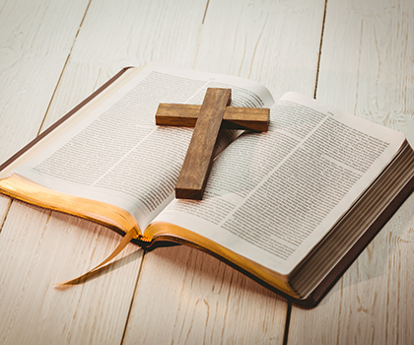
What purpose do they serve?
“Therefore many other signs Jesus also performed in the presence of the disciples, which are not written in this book; but these have been written so that you may believe that Jesus is the Christ, the Son of God; and that believing you may have life in His name.”
  John 20:30-31

Slide 5
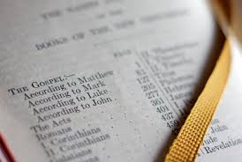
Why four?
The credibility of multiple witnesses
  Deuteronomy 19:15
  2 Corinthians 13:1
Diversity of background
  Matthew 9:9; Acts 12:12,25; Colossians 4:14; Mark 1:19
Difference of emphasis
  Matthew – Jesus as the Perfect Lawgiver
  Mark – Jesus as the Active Messenger
  Luke – Jesus as the Son of Man for all
  John – Jesus as the Word, God Incarnate

Slide 6

Emphasis of Testimony
“And he who has seen has testified, and his testimony is true; and he knows that he is telling the truth, so that you also may believe.”
  John 19:35
“This is the disciple who is testifying to these things and wrote these things, and we know that his testimony is true.”
  John 21:24

Slide 7
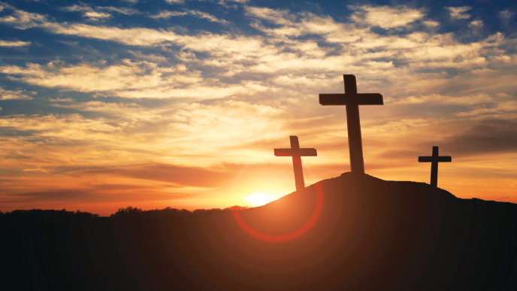
Consistency of Character
Matthew 1:1 – “The record of the genealogy of Jesus the Messiah, the son of David, the son of Abraham.”
Mark 1:1 – “The beginning of the gospel of Jesus Christ, the Son of God.”
Luke 3:22 – “And the Holy Spirit descended upon Him in bodily form like a dove, and a voice came out of heaven, ‘You are My beloved Son, in You I am well-pleased.’”
John 1:1-4 – “In the beginning was the Word, and the Word was with God, and the Word was God. He was in the beginning with God. All things came into being through Him, and apart from Him nothing came into being that has come into being. In Him was life, and the life was the Light of men.”

Slide 8

Consistency & Harmony in the Details
“Undesigned coincidences” – Details that fit together between different eyewitness testimonies
The empty water pots – John 2:1-7
  Mark 7:1-5; Matthew 15:2 – These were used for pre-meal washing
The green grass – Mark 6:39
  John 6:4, 10 – It was the time of Passover winter and spring rains would have made the grass green (which wasn’t the case all of the year).

Slide 9
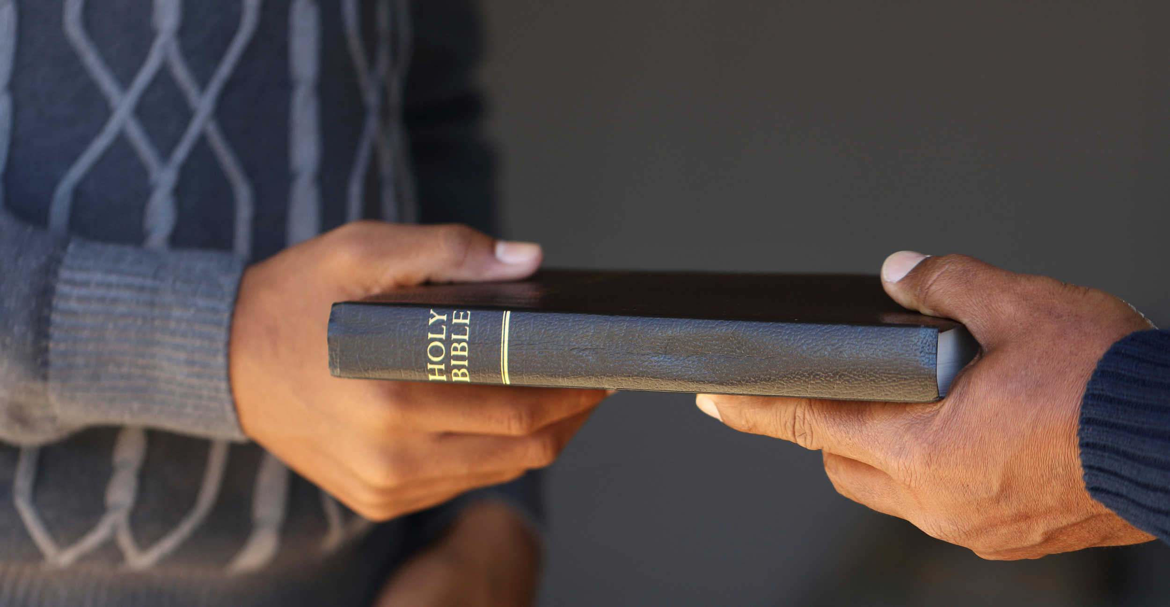
The Spirit’s Testimony
“But when He, the Spirit of truth, comes, He will guide you into all the truth; for He will not speak on His own initiative, but whatever He hears, He will speak; and He will disclose to you what is to come.”
  John 16:13
“All Scripture is inspired by God and profitable for teaching, for reproof, for correction, for training in righteousness; so that the man of God may be adequate, equipped for every good work.”
  2 Timothy 3:16-17

