Slide 1
Refuge

Slide 2
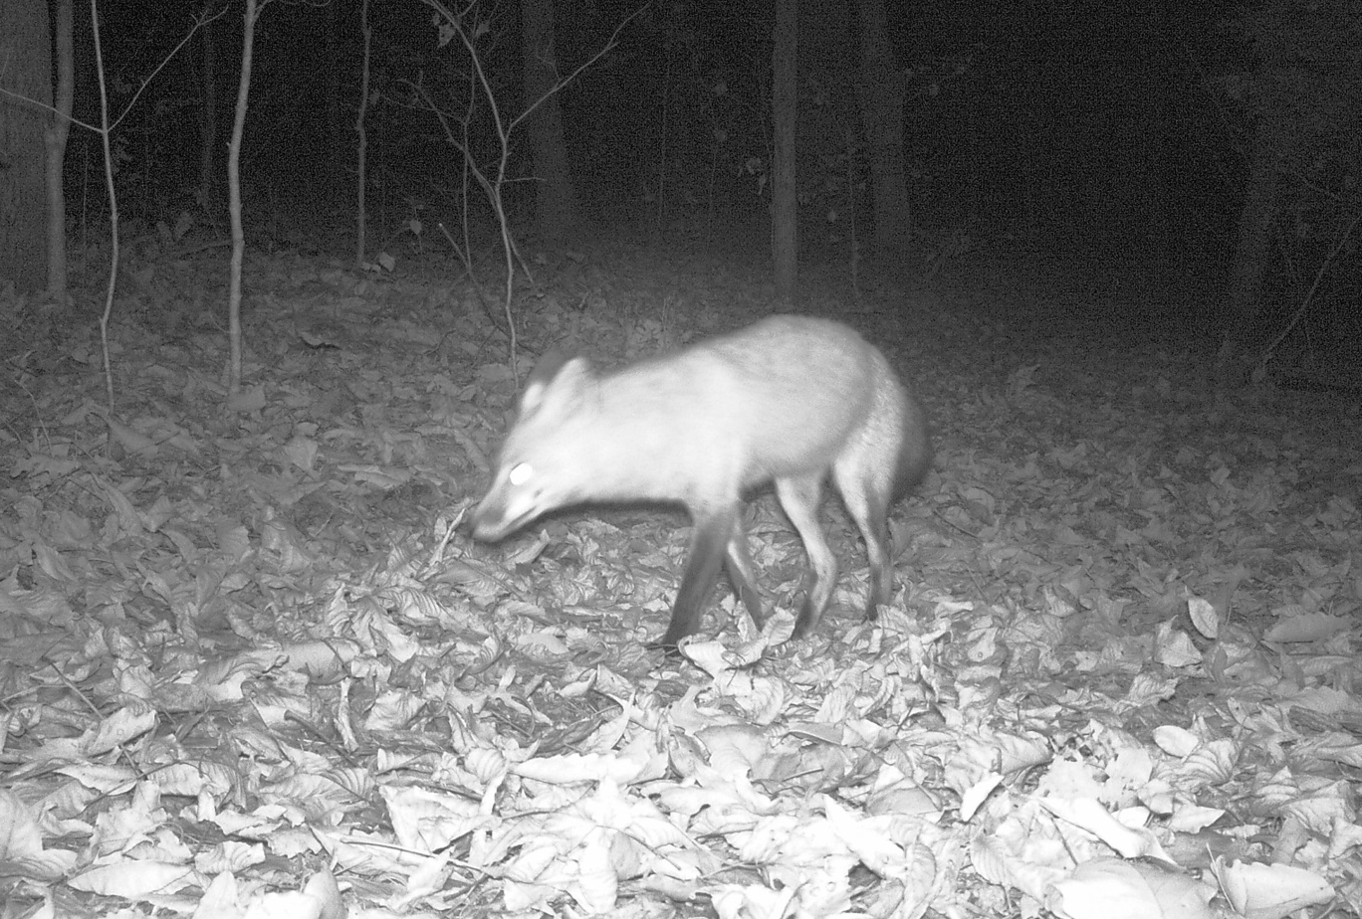

Slide 3
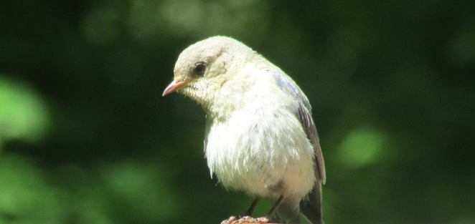
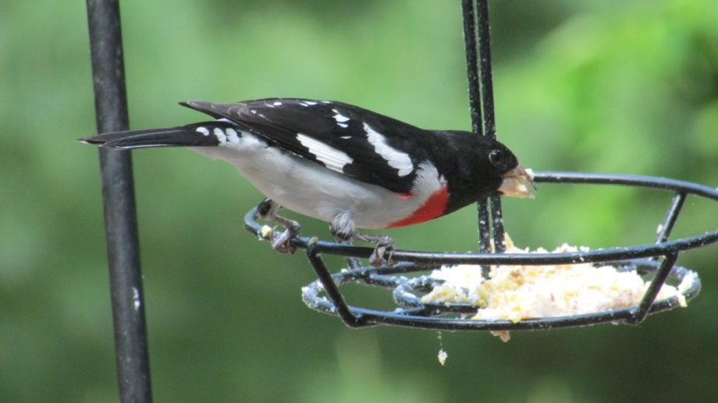
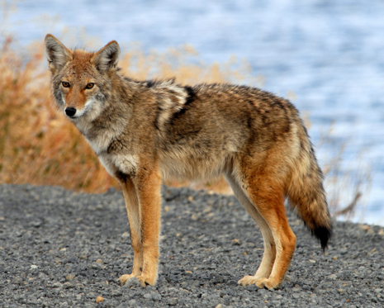

Slide 4
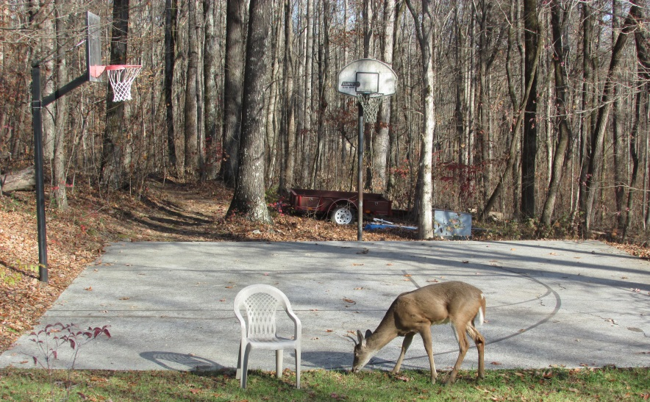
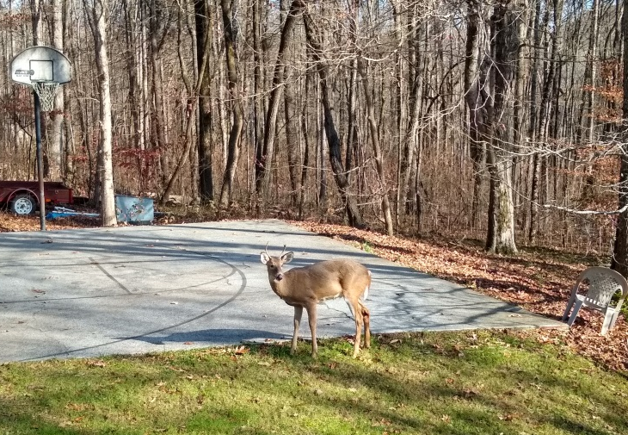
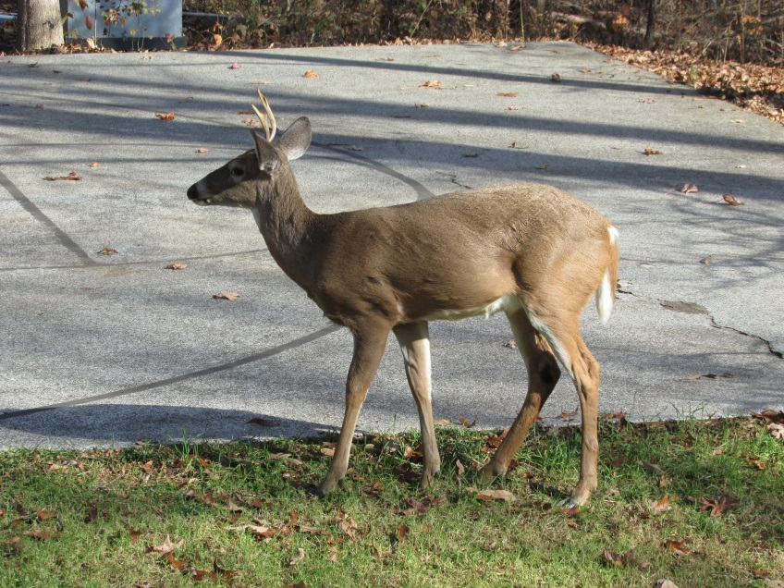
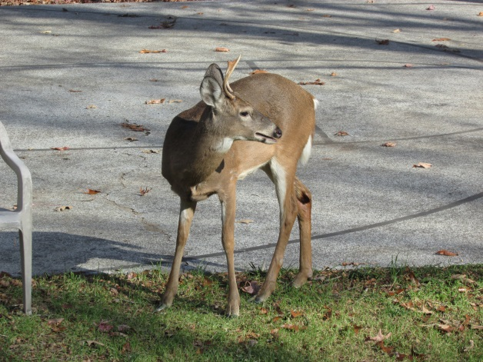

Slide 5
Refuge
Why do animals like hanging out on our property?
They know they are safe
No hunters are present
There is usually some sort of food for them
We do not usually harass them
They learn they are welcome most of the time
Refuge: Webster’s Definition
Shelter or protection from danger or distress
A place that provides shelter or protection
Other words; sanctuary, safe haven, retreat, preserve

Slide 6
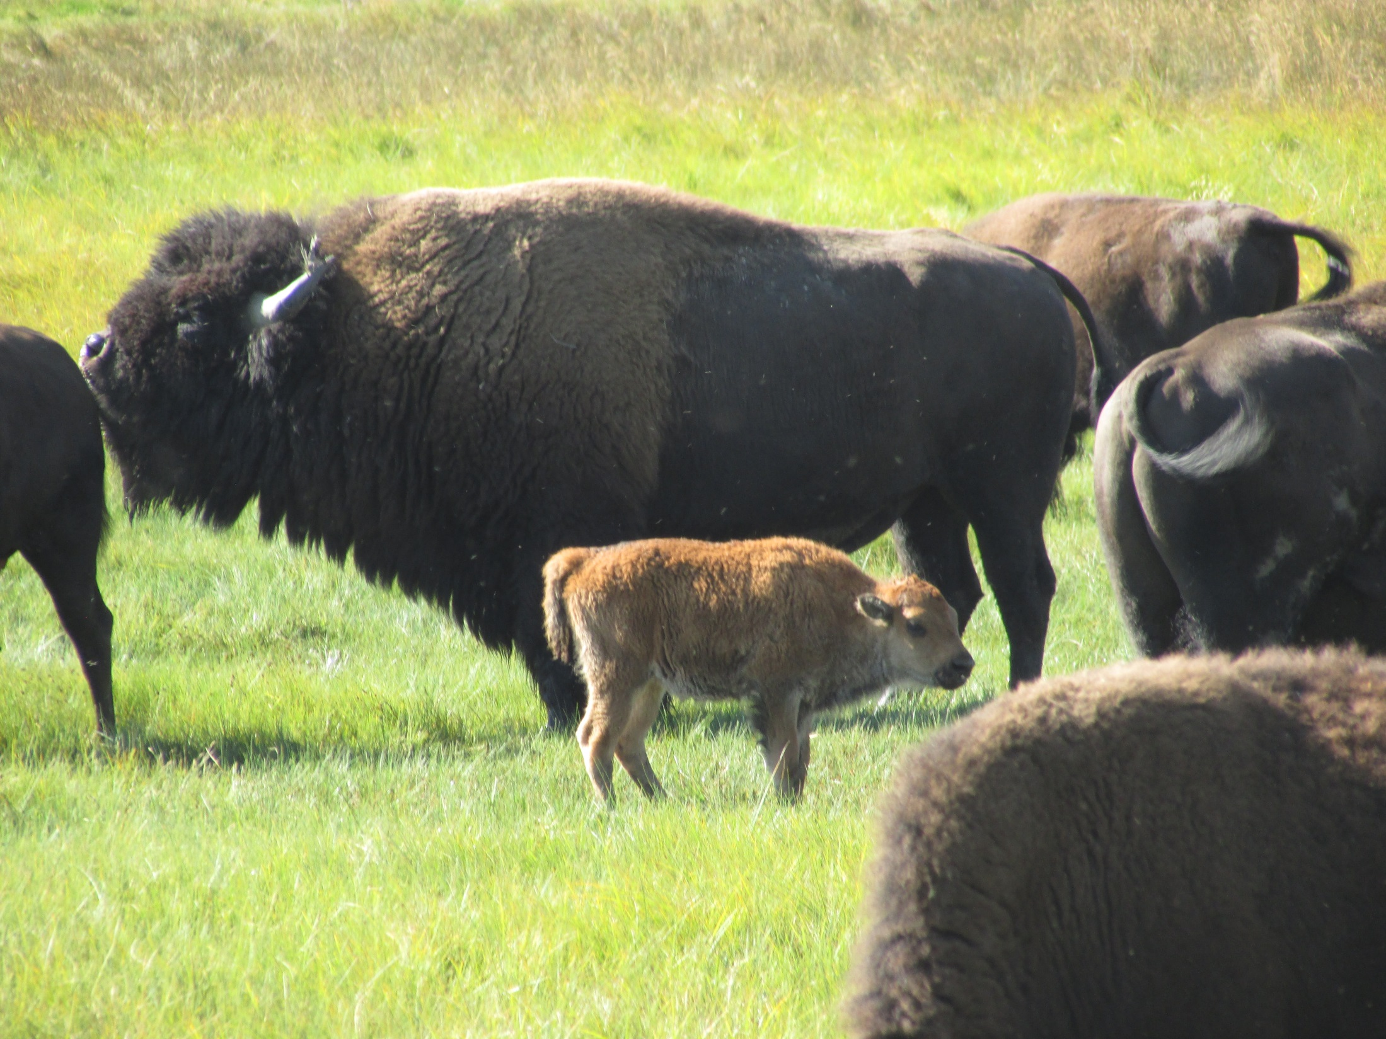

Slide 7
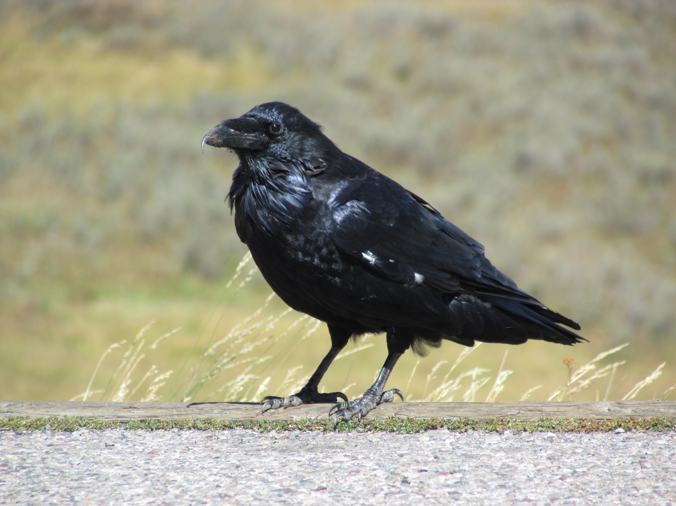

Slide 8
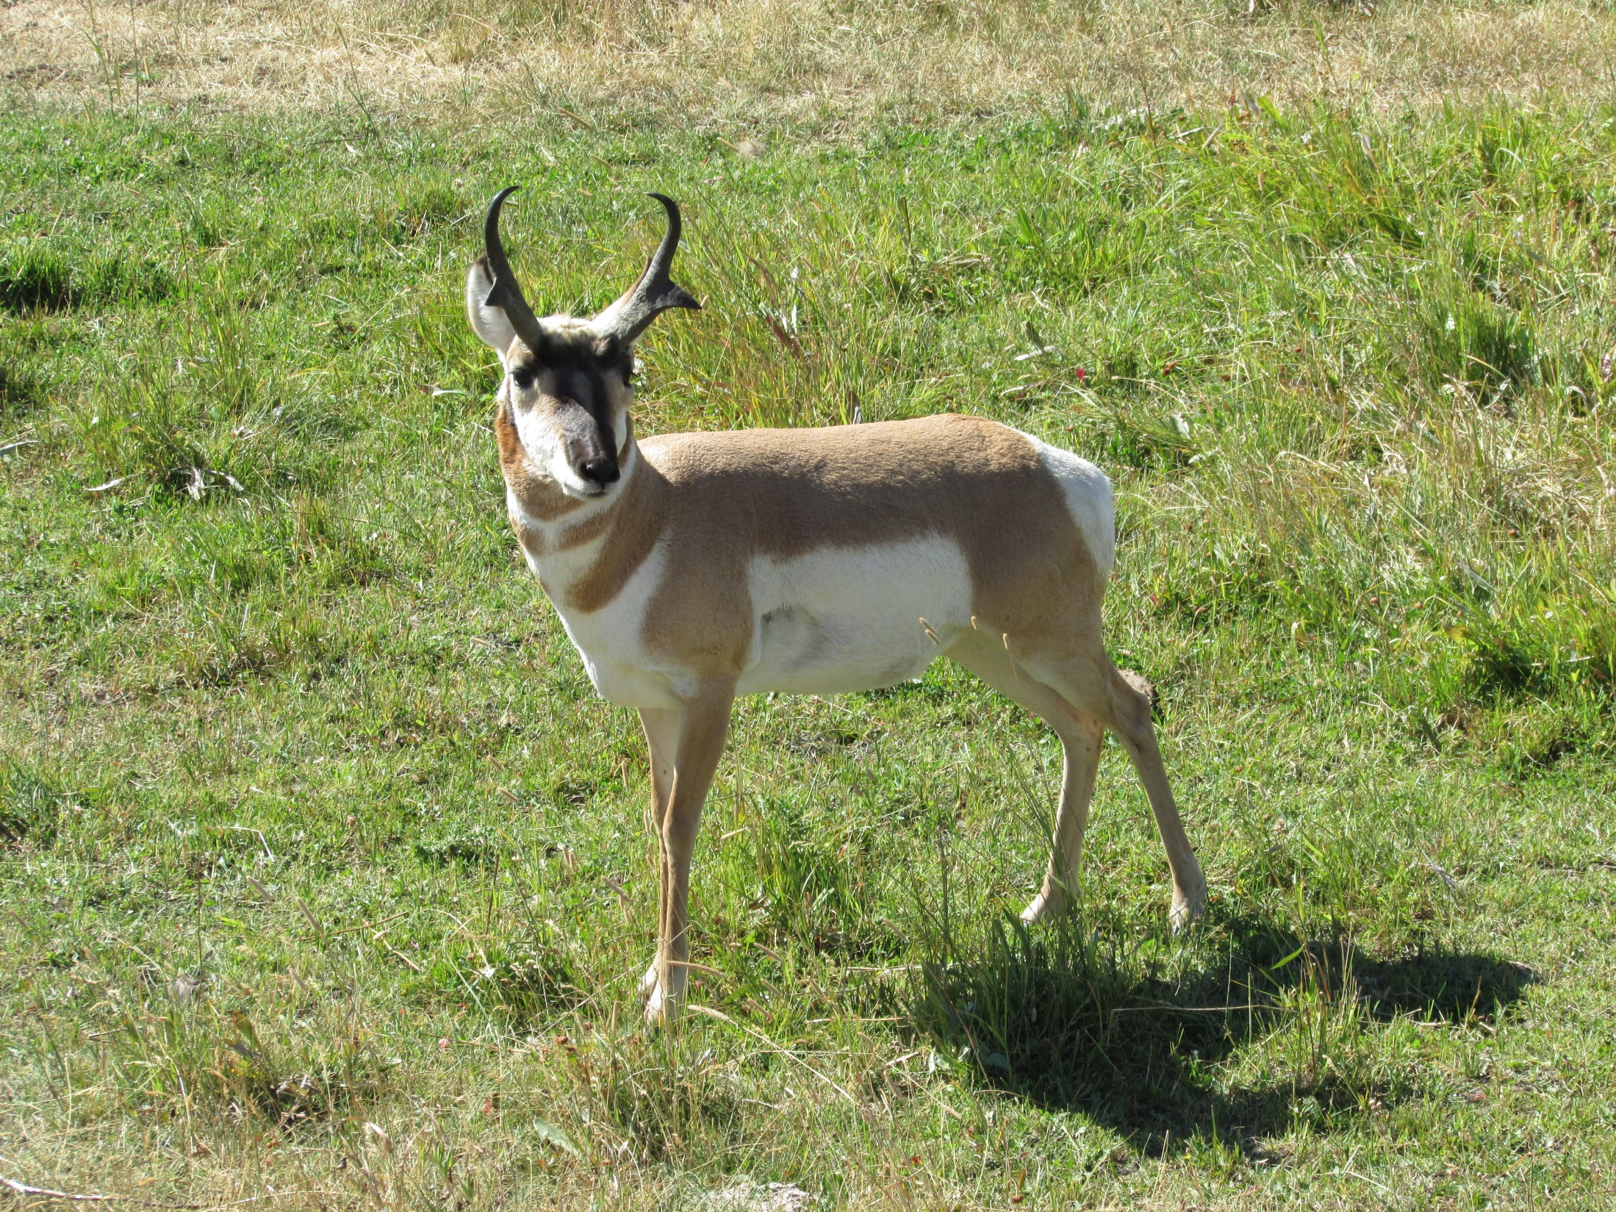

Slide 9
The Lord can be our Refuge!
He is the only true Refuge!
Deuteronomy 33:27; 2 Samuel 22:3;
Psalm 9:9; 46:1-3; 91:1-2, 4, 9; 142:3-5

Slide 10
Our Refuge Can Bring Us Peace
In our Physical Families
Romans 12:18, 1 Timothy 2:1-2

Slide 11
Our Refuge Can Bring Us Peace
2. In our Spiritual Family (flock)
Ruth 2:12, Psalm 28:8-9, Heb. 10:24-25, 13:20-21

Slide 12
Our Refuge Can Bring Us Peace
3. When we find ourselves Alone or are Troubled
2 Corinthians 7:5-7, Philippians 4:6-7, 2 Timothy 4:16-18

Slide 13
Our Refuge Can Bring Us Peace
4. Special gatherings with brethren
Mark 3:13-19

Slide 14
Our Refuge Can Bring Us Peace
5. Heaven
Revelation 7:13-17, 14:13

Slide 15
God Is Our Refuge
Let us make God our Refuge in our families, full of peace and love!
Let us make God our Refuge in our Oak Ridge church where there is encouragement, support, patience, mercy, and truth.
Let us remember we have a refuge, even when we are alone and troubled.
Let us treasure the time we have to spend with brethren.
Let us keep our Goal to one day be in the Eternal Refuge of Heaven!
But without God, we have No Refuge!

Slide 16
Psalm 23:1-6 (NKJV) A Psalm of David.
The LORD is my shepherd; I shall not want (lack). He makes me to lie down in green pastures; He leads me beside the still waters. He restores my soul; He leads me in the paths of righteousness For His name's sake. Yea, though I walk through the valley of the shadow of death, I will fear no evil; For You are with me; Your rod and Your staff, they comfort me. You prepare a table before me in the presence of my enemies; You anoint my head with oil; My cup runs over. Surely goodness and mercy shall follow me All the days of my life; And I will dwell in the house of the LORD Forever.

