Slide 1
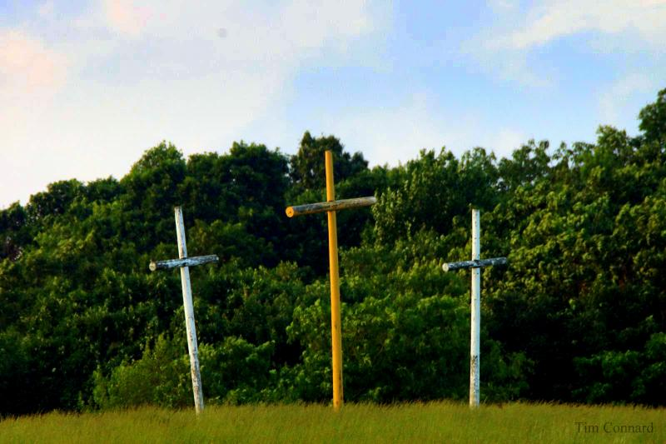
The Thief On The Cross

Slide 2
The Thief On The Cross

Slide 3
The Thief On The Cross
Many disciples of Christ who have engaged in conversations with religious people on the Biblical subject of conversion, have been asked, "What about the thief on the Cross?"

Slide 4
The Thief On The Cross
WHAT DO THE SCRIPTURES REVEAL ABOUT THIS MAN?
Information on the thief is found in 3 of 4 Gospels
Matthew 27:38-44
Mark 15:27-32
Luke 23:33, 39-43

Slide 5
The Thief On The Cross
Matthew 27:38-44 (NKJV): Then two robbers were crucified with Him, one on the right and another on the left. And those who passed by blasphemed Him, wagging their heads and saying, "You who destroy the temple and build it in three days, save Yourself! If You are the Son of God, come down from the cross. Likewise the chief priests also, mocking with the scribes and elders, said, "He saved others; Himself He cannot save. If He is the King of Israel, let Him now come down from the cross, and we will believe Him. He trusted in God; let Him deliver Him now if He will have Him; for He said, 'I am the Son of God.‘” Even the robbers who were crucified with Him reviled Him with the same thing.

Slide 6
The Thief On The Cross
Mark 15:27-32 (NKJV): With Him they also crucified two robbers, one on His right and the other on His left. So the Scripture was fulfilled which says, "And He was numbered with the transgressors." And those who passed by blasphemed Him, wagging their heads and saying, "Aha! You who destroy the temple and build it in three days, save Yourself, and come down from the cross!" Likewise the chief priests also, mocking among themselves with the scribes, said, "He saved others; Himself He cannot save. Let the Christ, the King of Israel, descend now from the cross, that we may see and believe." Even those who were crucified with Him reviled Him.”

Slide 7
The Thief On The Cross
Luke 23:33 (NKJV)
And when they had come to the place called Calvary, there they crucified Him, and the criminals, one on the right hand and the other on the left.

Slide 8
The Thief On The Cross
Luke 23:39-43 (NKJV)
Then one of the criminals who were hanged blasphemed Him, saying, "If You are the Christ, save Yourself and us." But the other, answering, rebuked him, saying, "Do you not even fear God, seeing you are under the same condemnation? And we indeed justly, for we receive the due reward of our deeds; but this Man has done nothing wrong." Then he said to Jesus, "Lord, remember me when You come into Your kingdom." And Jesus said to him, "Assuredly, I say to you, today you will be with Me in Paradise."

Slide 9
The Thief On The Cross
WHAT DO THE SCRIPTURES REVEAL ABOUT THIS MAN?
Luke's account relates the most information.
Matthew and Mark's accounts indicate both thieves reproached Christ (Matthew 27:44, Mark 15:32). In Luke's account we see one had a change of heart (Luke 23:40-41).
In Luke 23:42, one thief asks the Lord to remember him in His Kingdom. In Luke 23:43 Jesus tells him, today you will be with Me in Paradise.

Slide 10
The Thief On The Cross
To what place did Jesus and the thief go that day?
The original word translated "paradise" is defined as: "That part of Hades which is thought to be the abode of the souls of the pious until the resurrection." (Thayer).
In Acts 2:27, 31, after Jesus died he went to Hades, to the spirit World, the place where disembodied spirits go. According to Luke 16:19-31, "Hades" has three places: (1) A place of comfort (2) A place of torment (3) A great gulf (there is no passing from either place).
Christ went to Hades, or Paradise. On the day of Christ's death, the thief was going to Paradise with Christ to be comforted with the righteous of the ages.

Slide 11
The Thief On The Cross
The argument that is often made regarding the thief is: "I can be saved without being baptized because the thief was saved without being baptized." There are at least three false assumptions made regarding this argument.

Slide 12
The Thief On The Cross
SOME ARGUMENTS MADE REGARDING THE THIEF
Some assume that the thief was never baptized (Mark 1:4-5, Luke 7:29-20, John 4:1-2). The question is, is it possible that he could have been baptized?

Slide 13
The Thief On The Cross
SOME ARGUMENTS MADE REGARDING THE THIEF
Some assume they can be saved exactly like the thief. While Jesus was alive on earth, He had the power to give His Spiritual blessings to any as He saw fit (Mark 2:1-12, Luke 7:36-50, Mark 10:17-21). Jesus, during His personal ministry, granted God's blessings to several individuals upon various conditions, and the thief was one of them. What Jesus did for the thief, and others, has nothing to do with our salvation.

Slide 14
The Thief On The Cross
SOME ARGUMENTS MADE REGARDING THE THIEF
Some assume they are under the same Law the thief was under (Hebrews 7:12, 9:16-17, Romans 7:4, Hebrews 13:20). God will not change the conditions of the "everlasting covenant" that requires all to repent and be baptized. In the light of this, what does the argument "the thief was saved without being baptized" prove? Neither was Abraham, Moses, David, or any of the O.T. prophets baptized.

Slide 15
The Thief On The Cross
TODAY WHAT MUST ALL TO DO BE SAVED?
The New Testament of Jesus Christ established after his death on the cross, teaches that all must be baptized to be saved (Mark 16:16, Acts 2:38, 22:16; Romans 6:3-4; 1 Peter 3:21).

Slide 16
The Thief On The Cross
CONCLUSIONS
It is not wise to base one's entire Salvation on the assumption that one can be saved like the thief.
If one can make the argument, "I can be saved without being baptized because the thief was saved without being baptized," then many other excuses can be made to not obey the Lord.
When one becomes a disciple of Christ in the N.T., one obeys the command to be baptized to wash away their sins (Luke 7:29-30, Galatians 3:26-27).

Slide 17
The Thief On The Cross
HOW ABOUT YOU THIS MORNING?
Maybe a Christian? Are you striving to humble yourself to the Lord’s will every day. Satan gives us many opportunities to make excuses to disobey His will.
Maybe you are not a Christian? If you want to one day be comforted in Paradise, the Lord commands that all repent and be baptized to wash away their sins. No better time than now to make the most important decision for good you will ever make!

