Slide 1
THE FREE GIFT
Romans 5:1-5 (NKJV) Therefore, having been justified by faith, we have peace with God through our Lord Jesus Christ, through whom also we have access by faith into this grace in which we stand, and rejoice in hope of the glory of God. And not only that, but we also glory in tribulations, knowing that tribulation produces perseverance; and perseverance, character; and character, hope. Now hope does not disappoint, because the love of God has been poured out in our hearts by the Holy Spirit who was given to us.

Slide 2
THE FREE GIFT
Romans 5:6-11 (NKJV) For when we were still without strength, in due time Christ died for the ungodly. For scarcely for a righteous man will one die; yet perhaps for a good man someone would even dare to die. But God demonstrates His own love toward us, in that while we were still sinners, Christ died for us. Much more then, having now been justified by His blood, we shall be saved from wrath through Him. For if when we were enemies we were reconciled to God through the death of His Son, much more, having been reconciled, we shall be saved by His life. And not only that, but we also rejoice in God through our Lord Jesus Christ, through whom we have now received the reconciliation.

Slide 3
THE FREE GIFT
Romans 5:12-16 (NKJV) Therefore, just as through one man sin entered the world, and death through sin, and thus death spread to all men, because all sinned-- For until the law sin was in the world, but sin is not imputed when there is no law. Nevertheless death reigned from Adam to Moses, even over those who had not sinned according to the likeness of the transgression of Adam, who is a type of Him who was to come. But the free gift is not like the offense. For if by the one man's offense many died, much more the grace of God and the gift by the grace of the one Man, Jesus Christ, abounded to many. And the gift is not like that which came through the one who sinned. For the judgment which came from one offense resulted in condemnation, but the free gift which came from many offenses resulted in justification.

Slide 4
THE FREE GIFT
Romans 5:17-21 (NKJV) For if by the one man's offense death reigned through the one, much more those who receive abundance of grace and of the gift of righteousness will reign in life through the One, Jesus Christ. Therefore, as through one man's offense judgment came to all men, resulting in condemnation, even so through one Man's righteous act the free gift came to all men, resulting in justification of life. For as by one man's disobedience many were made sinners, so also by one Man's obedience many will be made righteous. Moreover the law entered that the offense might abound. But where sin abounded, grace abounded much more, so that as sin reigned in death, even so grace might reign through righteousness to eternal life through Jesus Christ our Lord.

Slide 5
THE FREE GIFT
Why was the Free Gift needed?
We all are ungodly and in sin (Romans 5:6)
God is merciful and loves us (Romans 5:5, 8)
By faith we can now be justified, saved, reconciled (Romans 5:1, 9, 10-11, 18)
God is just – atonement for our sin was necessary (Ephesians 5:2, Hebrews 9:27-28)

Slide 6
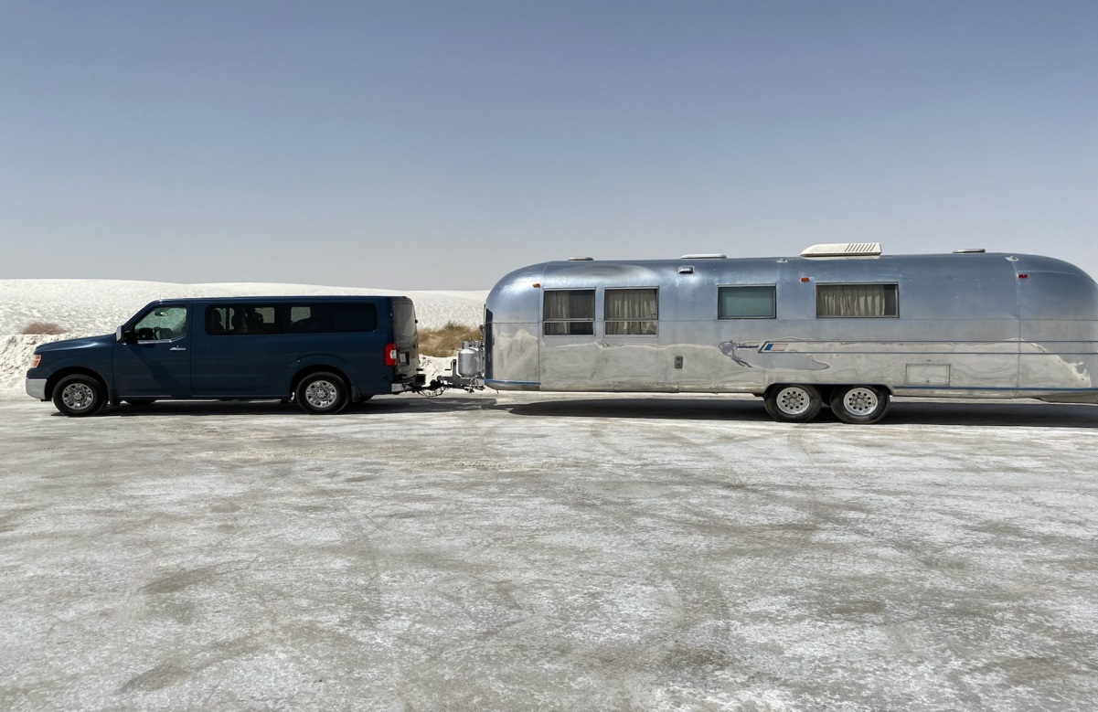

Slide 7
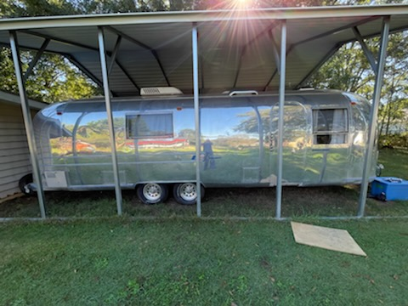

Slide 8
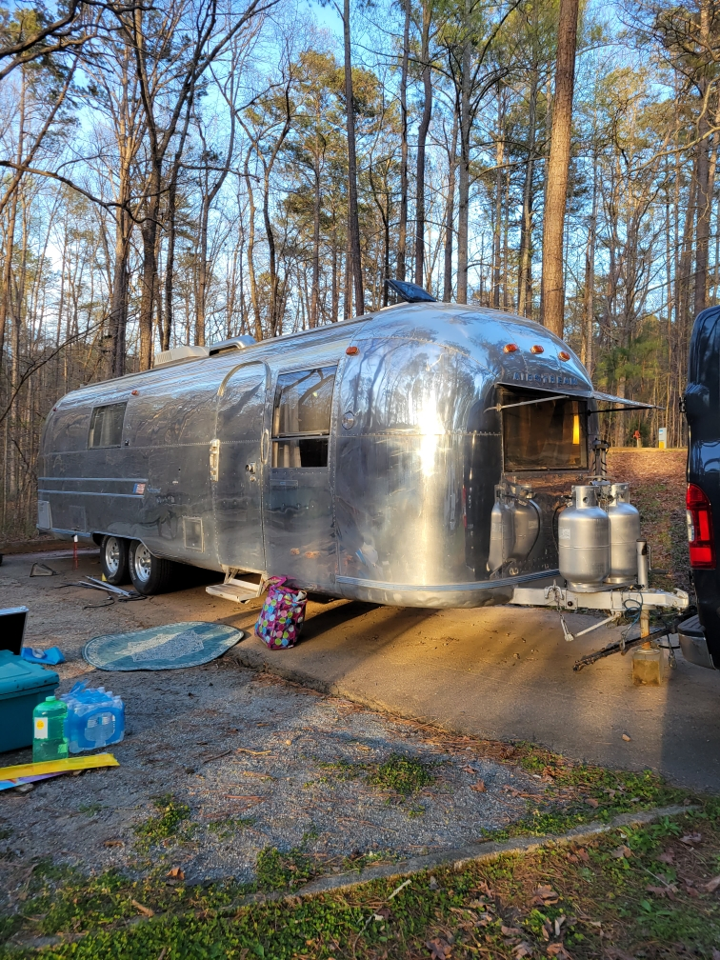

Slide 9
THE FREE GIFT
Even though the Gift is Free:
We have to get it (Romans 5:2)
We have to be thankful (2 Cor. 2:14, 9:15)
We have to maintain it (1 Tim. 1:19, Titus 3:8, 1 John 1:8-10)
We have to share it (Acts 8:4)

Slide 10
THE FREE GIFT
The Free Gift has conditions:
Hear & Understand (Acts 8:30-35)
Believe & Confess (Acts 8:36-37)
Repent (Acts 17:30)
Baptized (Acts 8:38, 22:16)
Diligently serve and grow in the Lord
(1 Corinthians 15:58, 2 Peter 3:17-18)

Slide 11
THE FREE GIFT
Romans 6:3-7 (NKJV) Or do you not know that as many of us as were baptized into Christ Jesus were baptized into His death? Therefore we were buried with Him through baptism into death, that just as Christ was raised from the dead by the glory of the Father, even so we also should walk in newness of life. For if we have been united together in the likeness of His death, certainly we also shall be in the likeness of His resurrection, knowing this, that our old man was crucified with Him, that the body of sin might be done away with, that we should no longer be slaves of sin. For he who has died has been freed from sin.

Slide 12
THE FREE GIFT
Have you obtained your Free Gift?

Slide 13
THE FREE GIFT
Romans 6:11 (NKJV) Likewise you also, reckon yourselves to be dead indeed to sin, but alive to God in Christ Jesus our Lord.
Romans 6:13 (NKJV) And do not present your members as instruments of unrighteousness to sin, but present yourselves to God as being alive from the dead, and your members as instruments of righteousness to God.

Slide 14
THE FREE GIFT
Have you been thankful for your Free Gift?
Have you maintained your Free Gift?
Have you shared your Free Gift?

